Slide 1
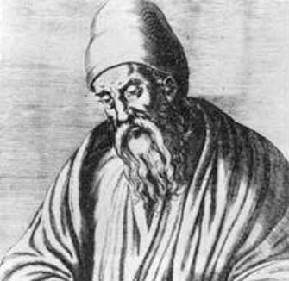
Euclid of Alexandria
325 – 265 B.C.
Euclid was a Greek mathematician best known for his treatise on geometry: The Elements. This influenced the development of Western mathematics for more than 2000 years and counting.

Slide 2
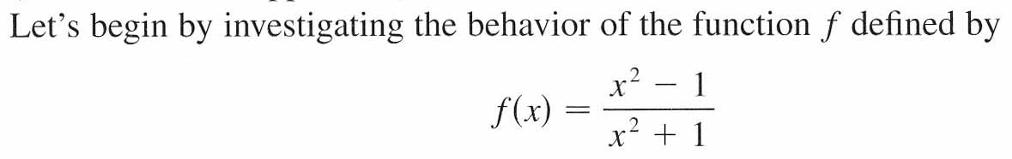
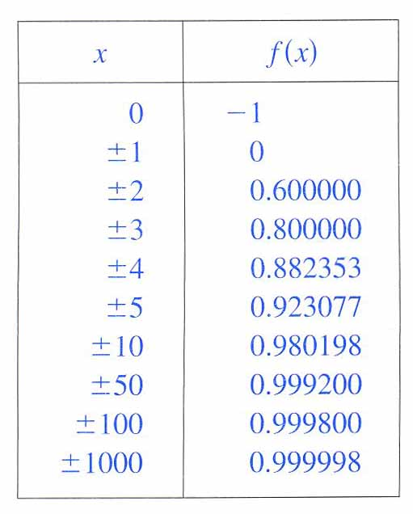
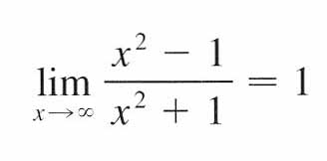
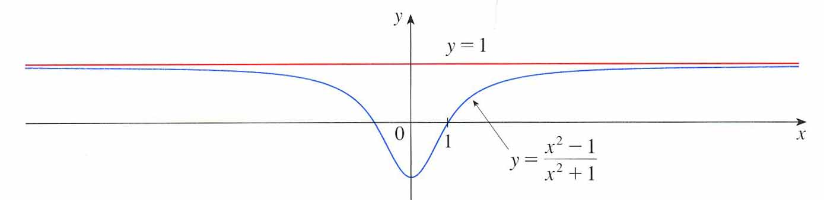
So, we say,
These limits shows that f (x) has a horizontal asymptote at y = 1.
Left-Hand Behavior
Right-Hand Behavior

Slide 3
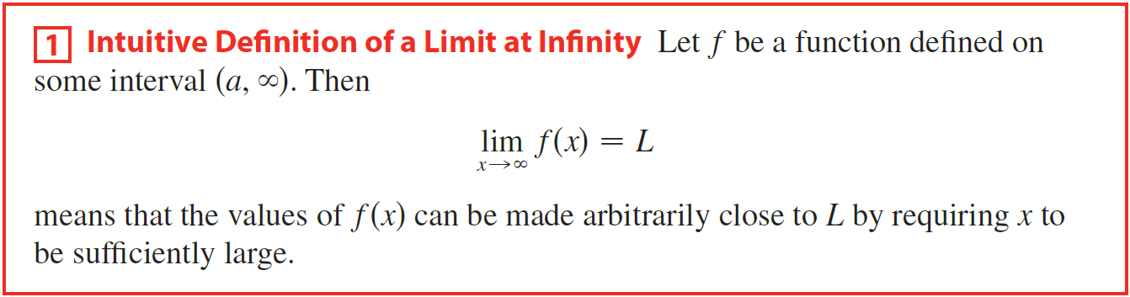
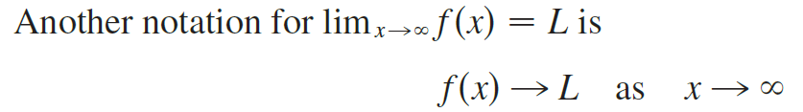
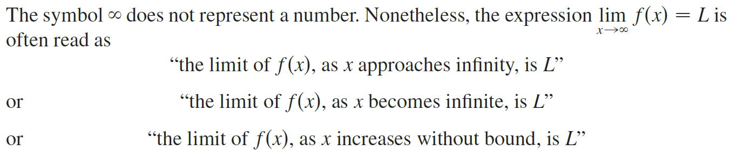


Slide 4
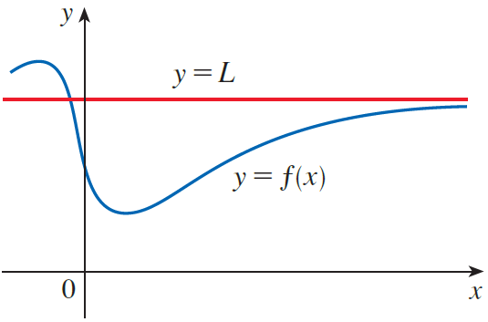
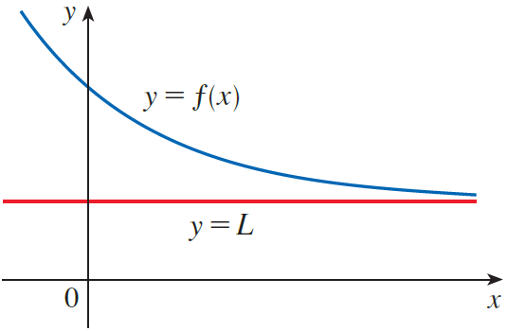
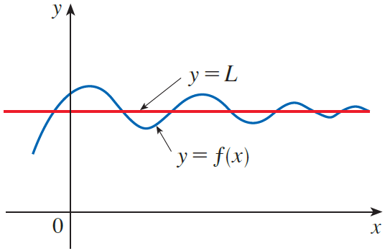

We take limits to infinity to analyze end-behavior of functions.
Right-Hand Behavior
Right-Hand Behavior
Right-Hand Behavior

Slide 5
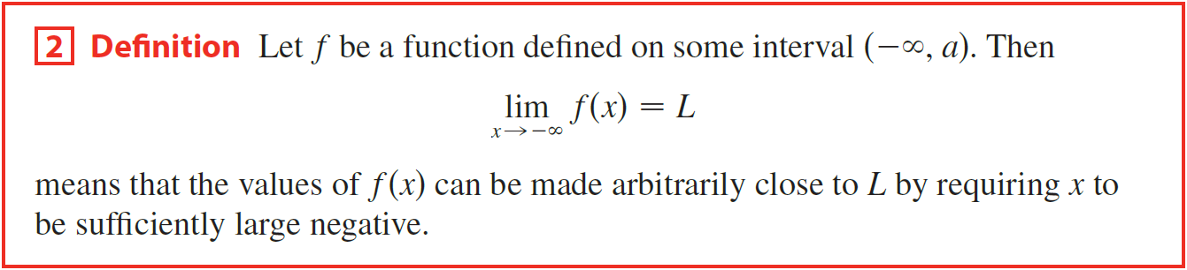
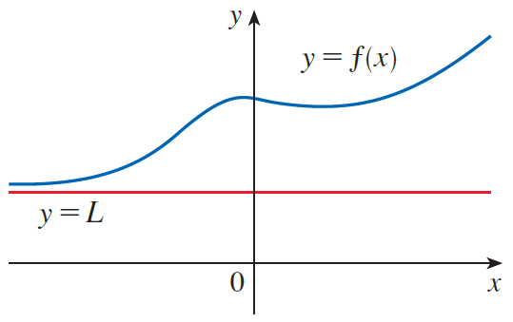
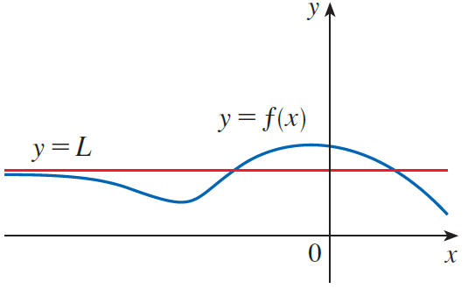

Left-Hand Behavior
Left-Hand Behavior

Slide 6
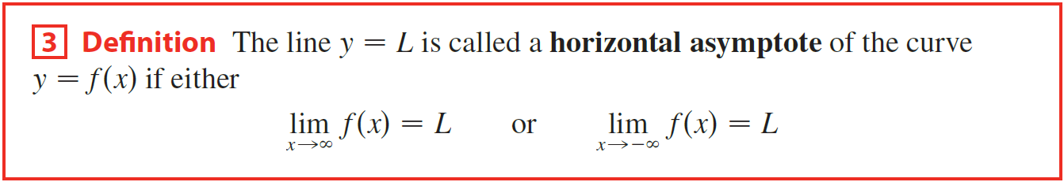
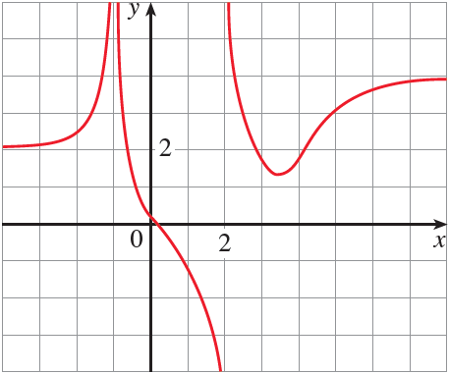



Example
Find the infinite limits, limits at infinity, and asymptotes for the function f whose graph is shown in the figure.
Solution

Slide 7
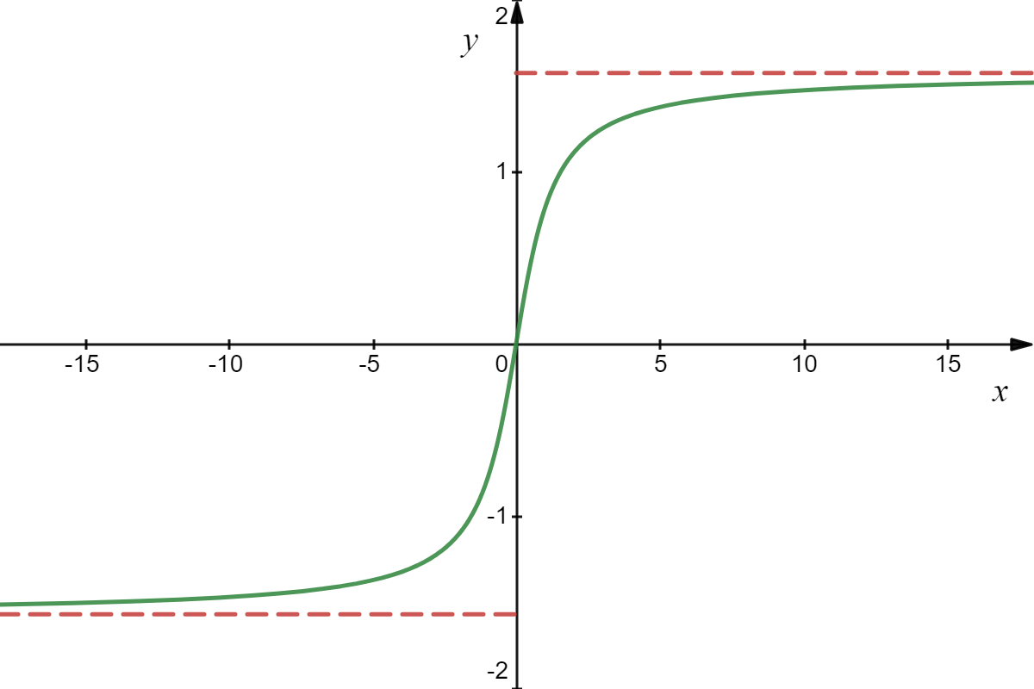
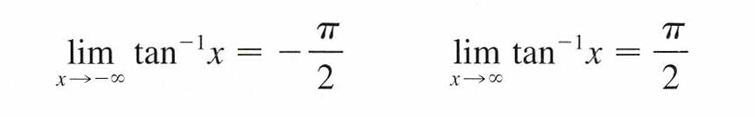
Example
Solution

Slide 8
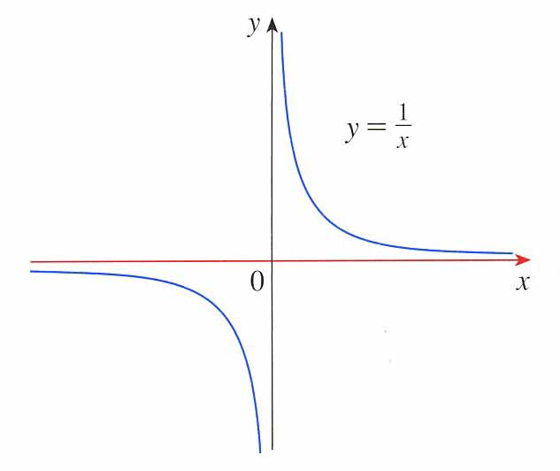
Recall
horizontal asymptote at y = 0.
vertical asymptote at x = 0.
In 2.3 these limits showed x = 0 is a vertical asymptote.
In these limits, as the denominator gets larger, the value of the fraction gets closer to zero. So, by definition, y = 0 is a horizontal asymptote.

Slide 9

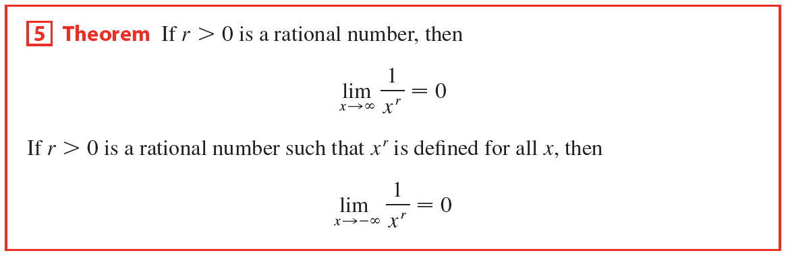

Slide 10
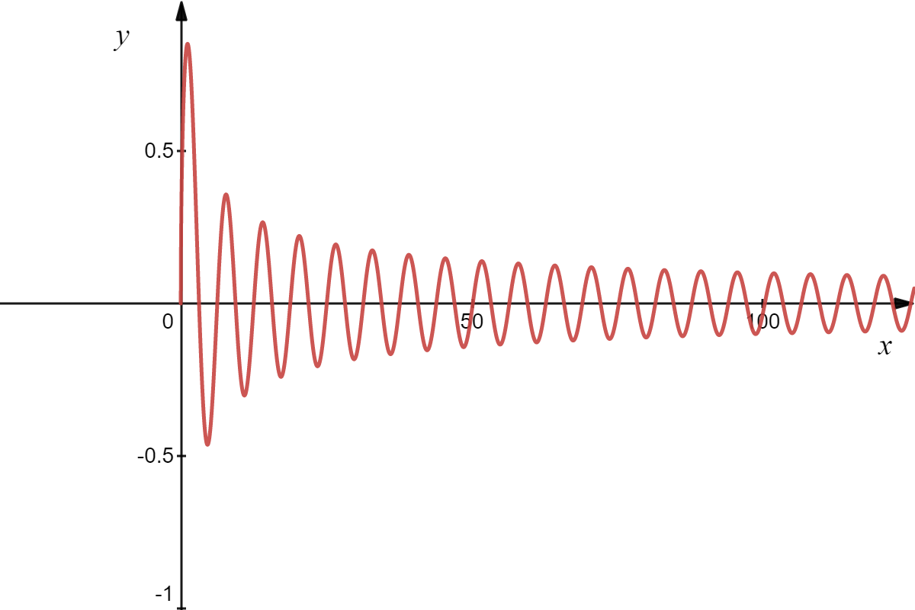
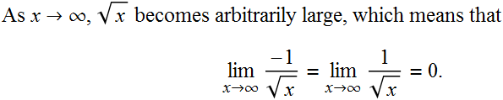
Example
Find:
Solution
When we graph this function,
the limit appears to be zero.
(2) Theorem 5

Slide 11
Example
Find:
Solution
When we graph this function,
the limit appears to be zero.
Thus, by the Squeeze Theorem:

Slide 12

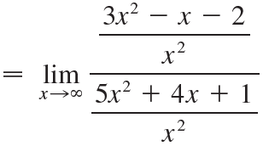
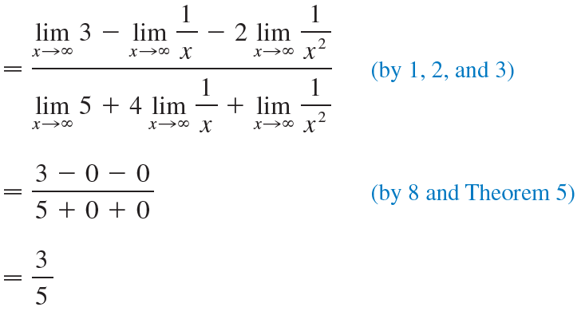

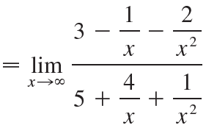
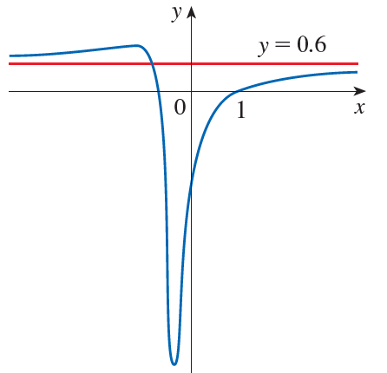
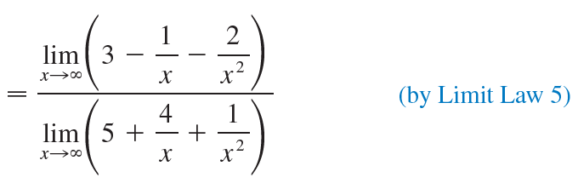
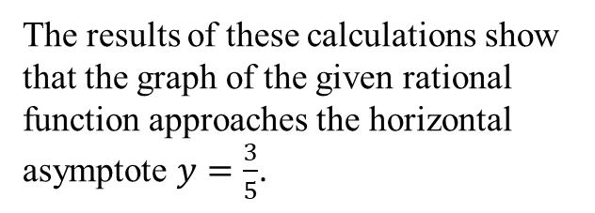
Example
Evaluate the following limit and indicate which properties of limits are used at each stage.
Solution
We first divide both the
numerator and denominator
by the highest power of x that
occurs in the denominator.
The results of these calculations show
that the graph of the given rational
function approaches the horizontal
asymptote $y=\frac{3}{5}$.

Slide 13
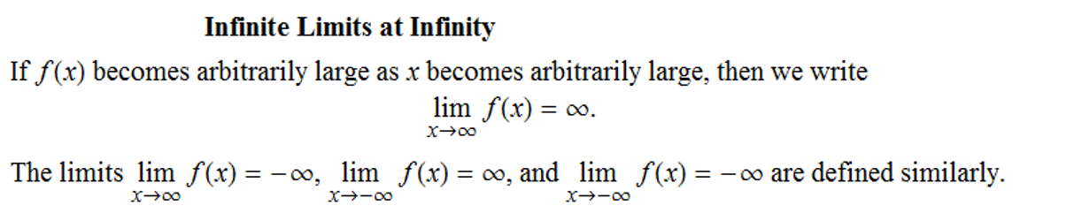

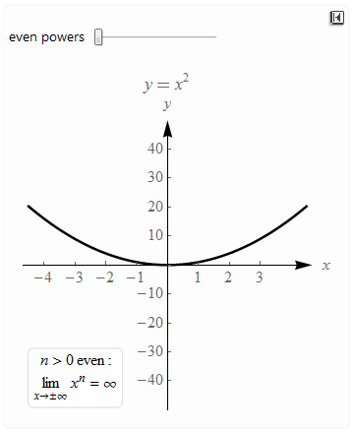
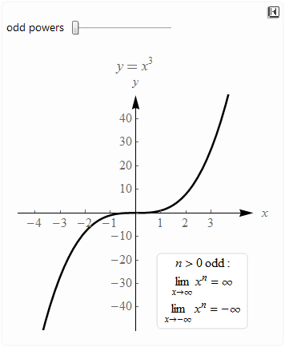



4
For polynomials

Slide 14
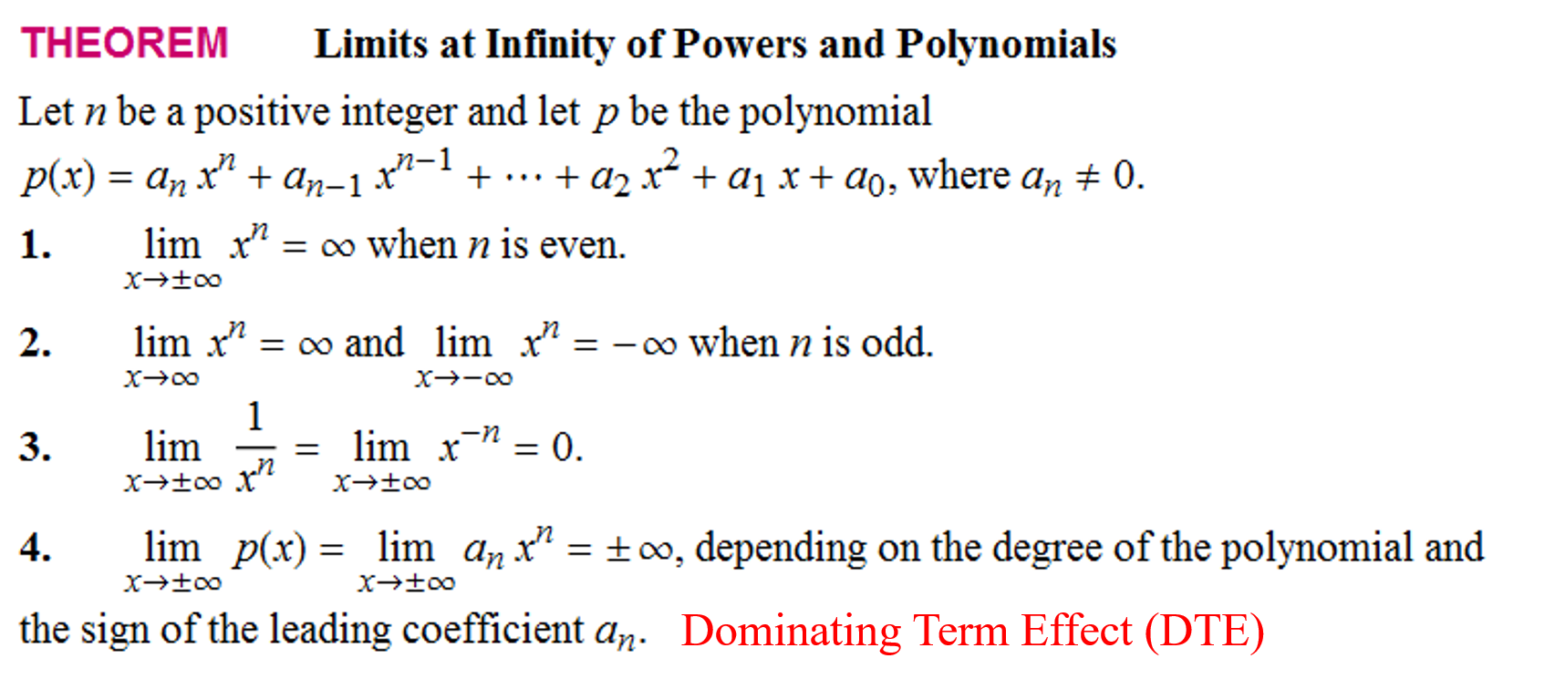



Slide 15



Example
Solution
Theorem Limits at Infinity of Powers and Polynomials (DTE)
DTE
Dominating term
DTE

Slide 16
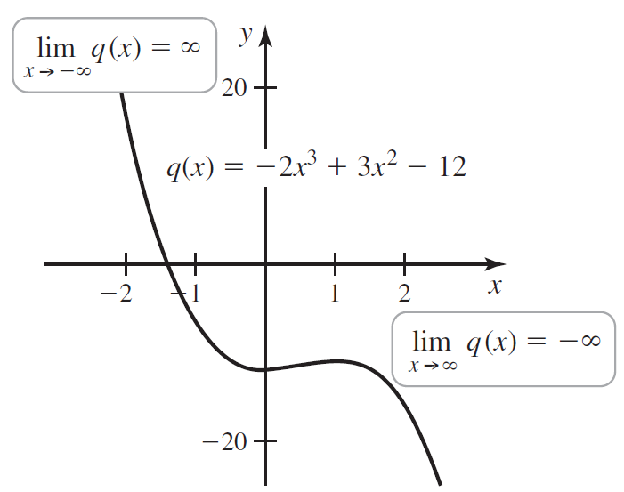

Slide 17
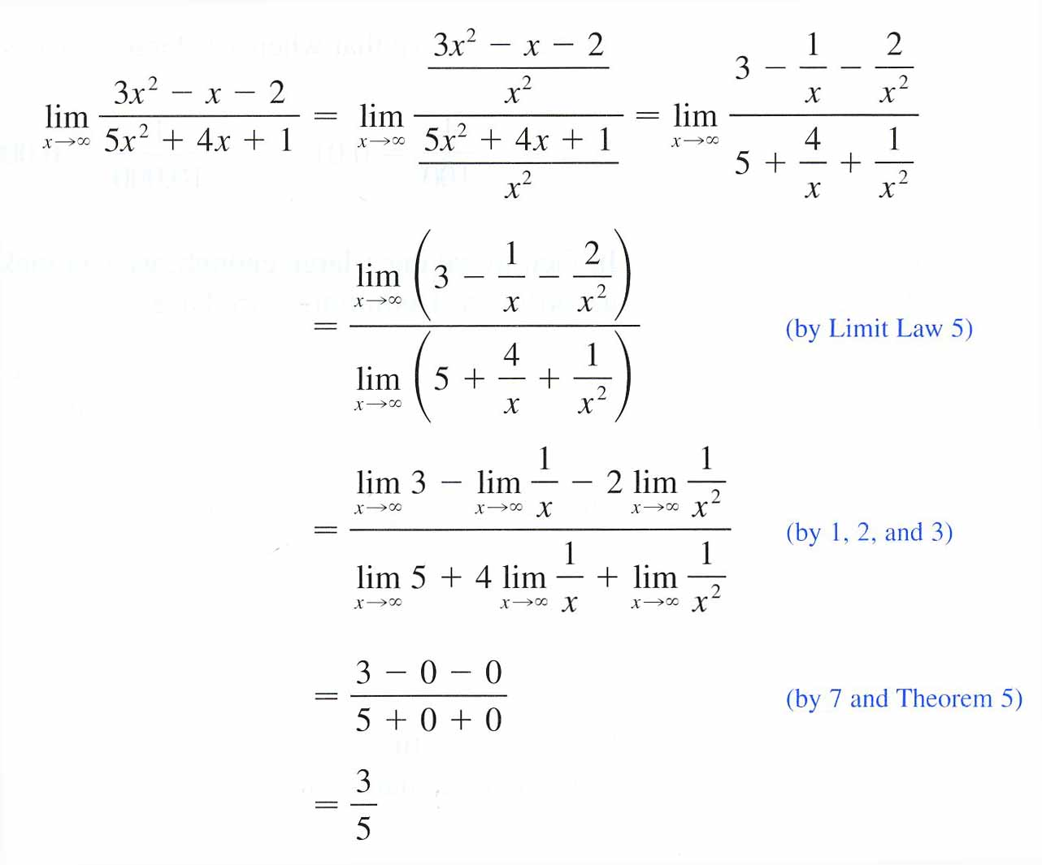
Algebraic Limits
Method I
Method II
DTE
Theorem Limits at Infinity of
Powers and Polynomials (DTE)
Which method do you like better?
DTE can only be used with polynomials!
Theorem 5

Slide 18
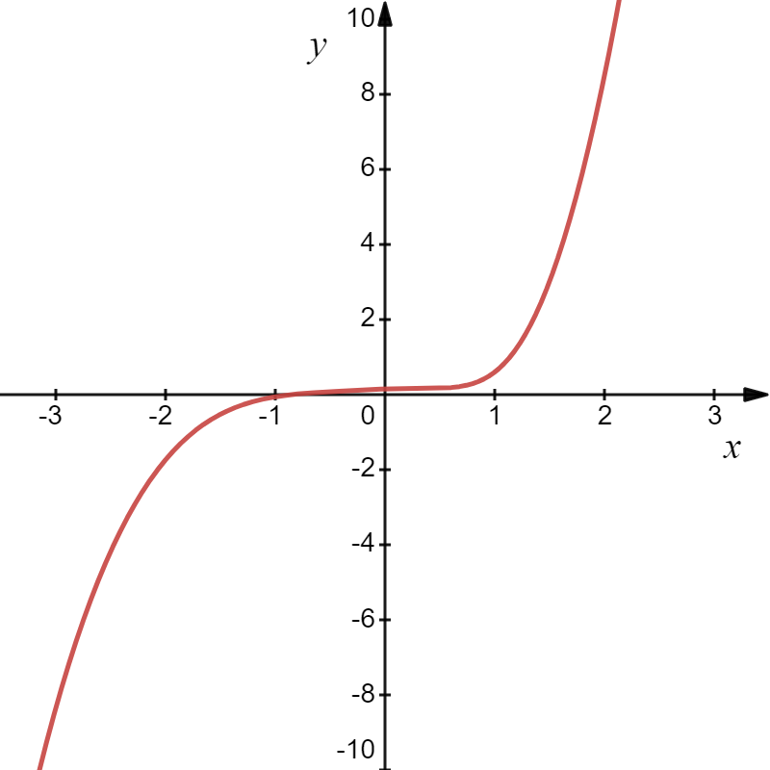
Example
Solution
Dominating term effect for rational functions (DTE) we get,
DTE
Dominant terms in numerator and denominator

Slide 19
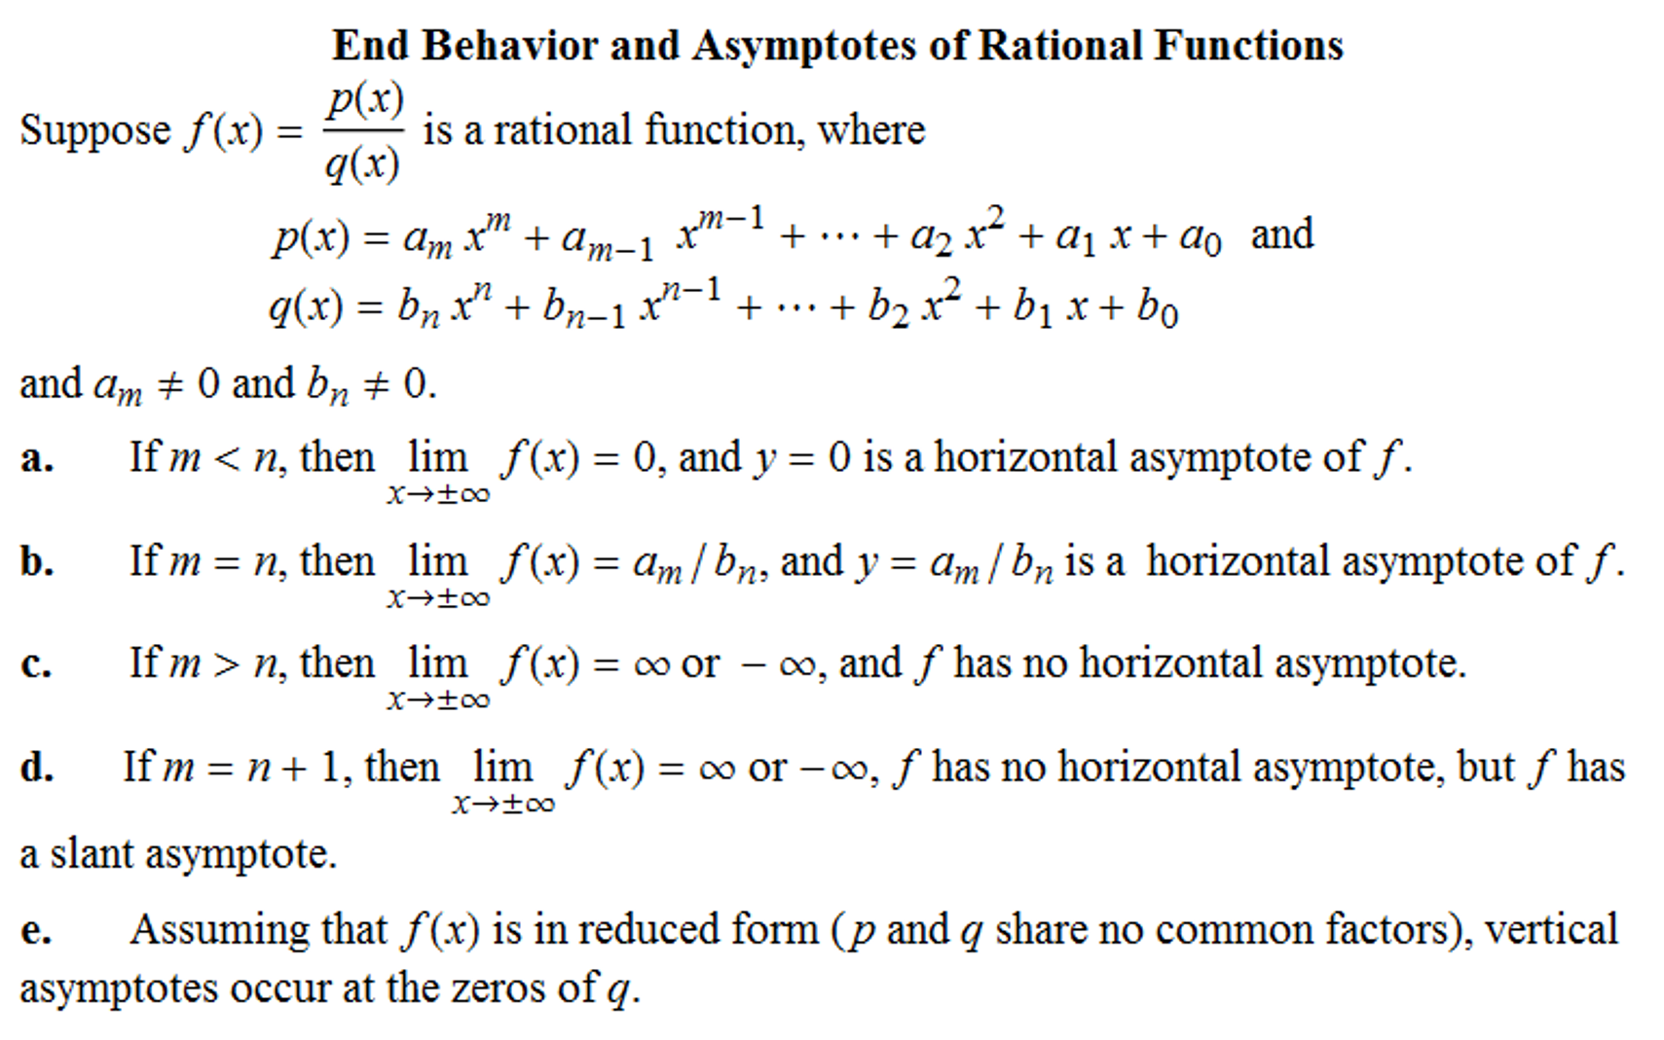

Slide 20
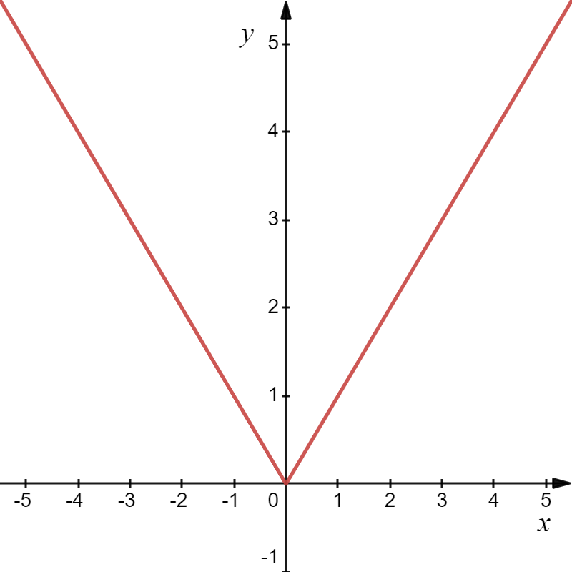
Recall:
Example
Piecewise Function

Slide 21
In general, we get the following 2 cases for roots of powers of the form
Cases 1: n is even
Cases 2: n is odd

Slide 22

Example
Solution
Left-Hand Behavior
Right-Hand Behavior

Slide 23
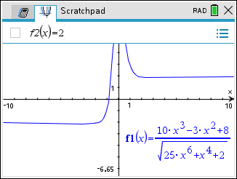
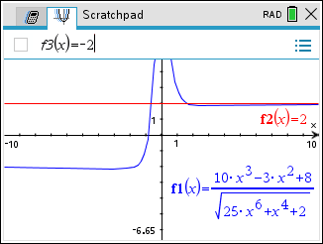
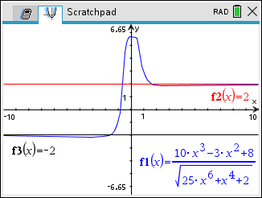

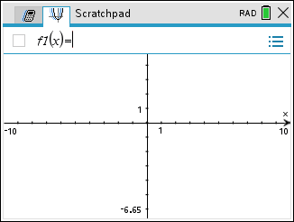
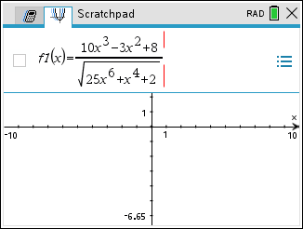
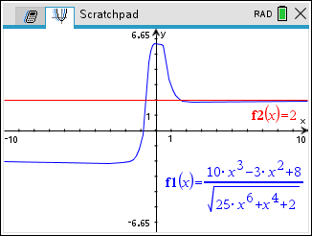
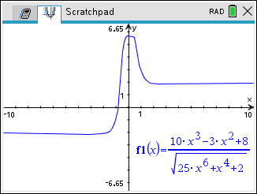
Example
Solution

Slide 24

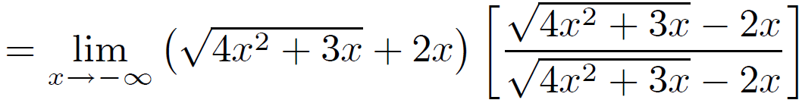
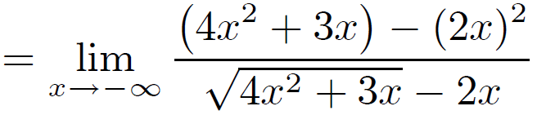
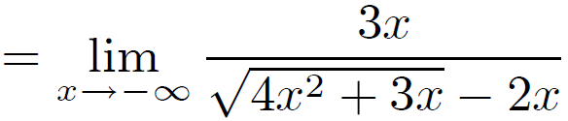
Example
Find the limit or show that it does not exist.
Solution

Slide 25
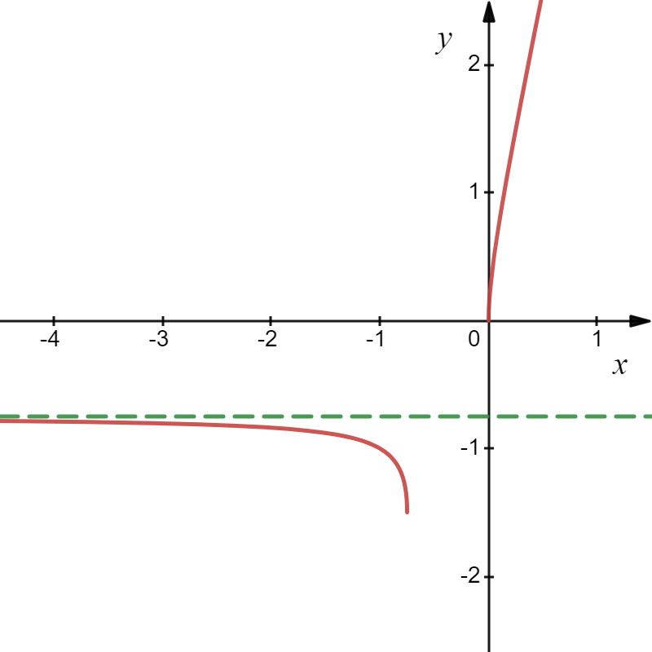

Example
Find the limit or show that it does not exist.
Solution

Slide 26
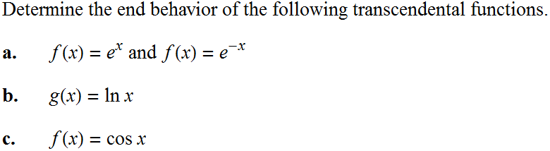




Example
Solution
a.
Hence, y = 0 is a horizontal asymptote.

Slide 27
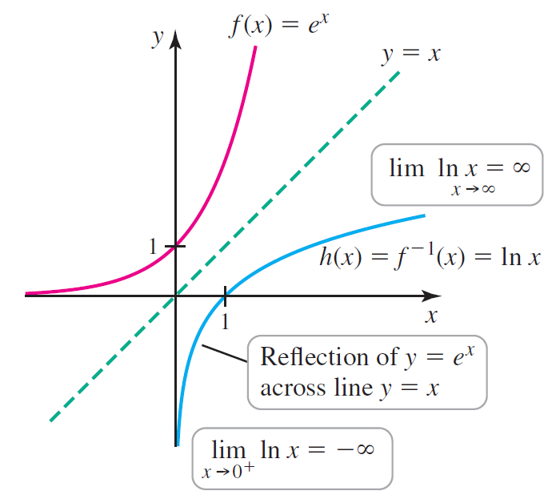


There is no left-hand behavior because of the domain restriction.
Hence, there is no horizontal asymptote.
So, x = 0 is a vertical asymptote.

Slide 28



Slide 29


In summary,
Example
Solution

Slide 30

Example
Solution

Slide 31
Example
Solution
0
0
0

Slide 32

Example
Solution
0
0
0
0

Slide 33

In summary,
Indeterminant Forms
The following expressions have no meaning and are thus called indeterminant forms. We will study these along with other indeterminate forms further using L'Hospital’s Theorem in Chapter 4.4.
More to come!!
Meaningful Expressions Involving 0 and $∞$
Let k be a fixed nonzero real number.
Bring on the homework!!

