Slide 1

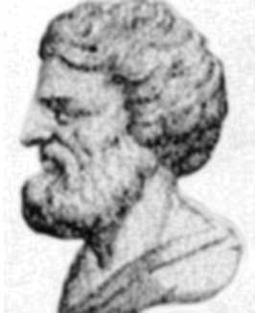
Apollonius of Perga
262 – 190 B.C.
Apollonius was a Greek mathematician known as 'The Great Geometer'. His works had a very great influence on the development of mathematics and his famous book Conics introduced the terms parabola, ellipse and hyperbola.

Slide 2
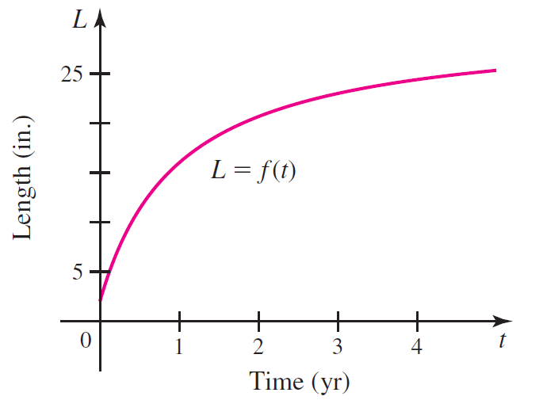
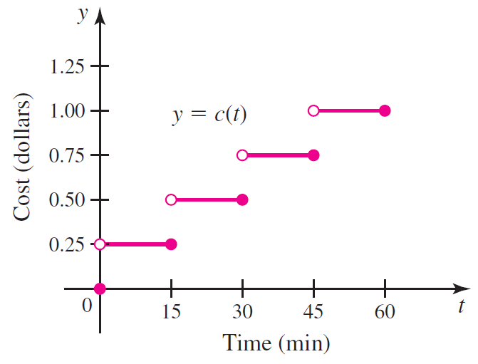

Most of the techniques of calculus require that functions be continuous. A function is continuous if you can draw it in one motion without picking up your pencil.
Length of Fish
Parking Meter Cost

Slide 3
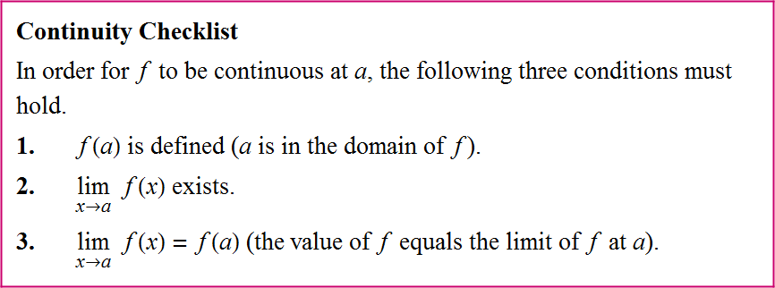

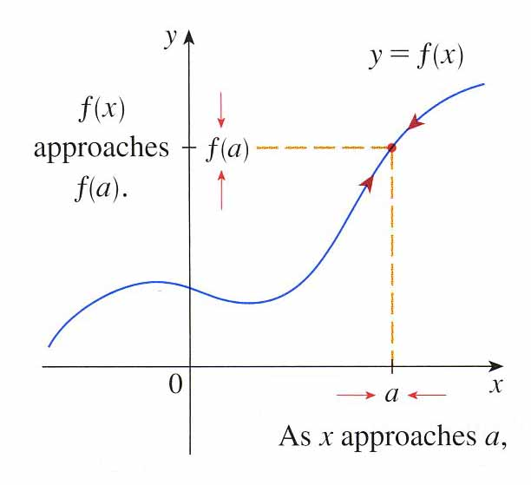
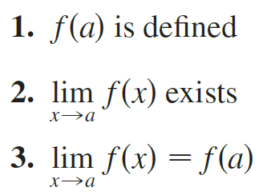

Slide 4
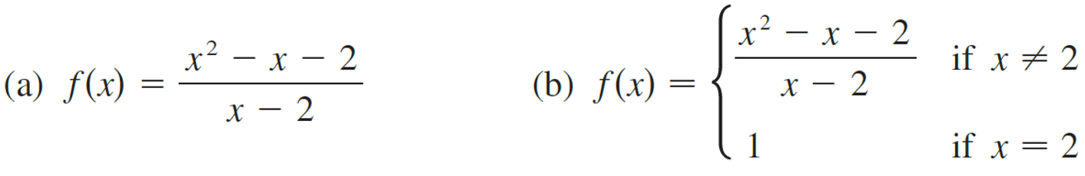

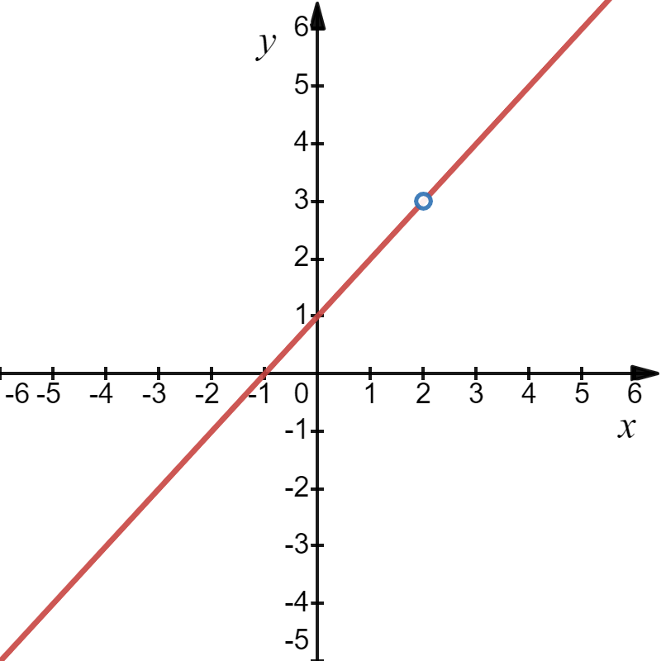
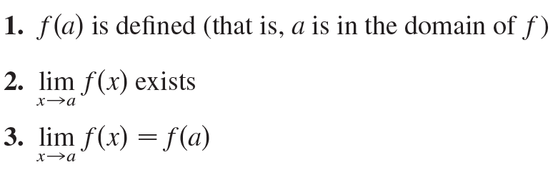

Example
Where are each of the following functions discontinuous?
Solution
1. f (2) is undefined, division by zero.
So, f (x) is discontinuous at x = 2.
Undefined Discontinuity at x = 2.

Slide 5






Example
Where are each of the following functions discontinuous?
Solution
3.
But
1. f (2) = 1 is defined
So, f is not continuous at 2.
2.

Slide 6








Example
Use the definition of continuity and the properties of limits to show that the function is continuous at the
given number a.
Solution
exists
1. f (−2)
3.
is defined
Hence, f (r) is continuous at −2.
2.

Slide 7
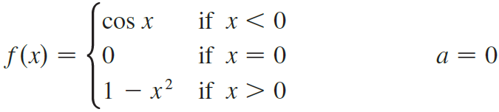




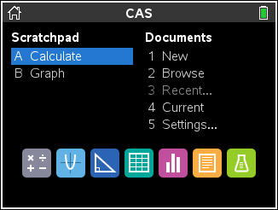

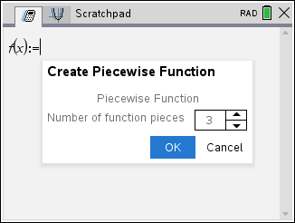
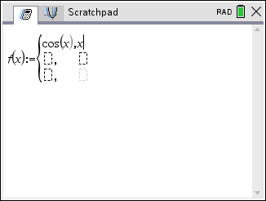
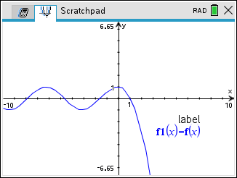
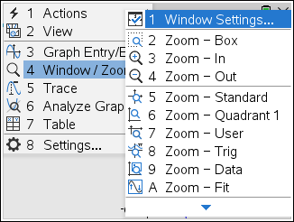
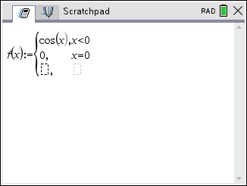
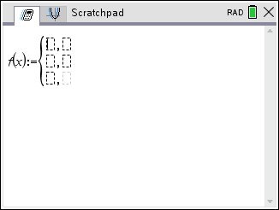
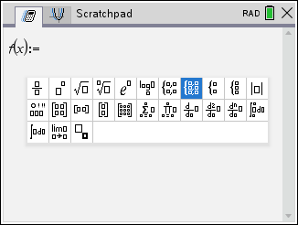
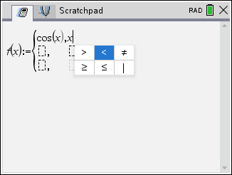

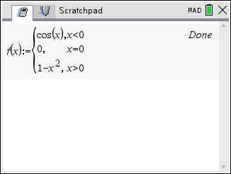
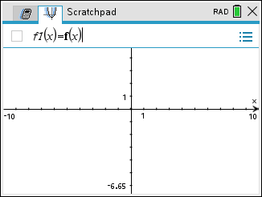
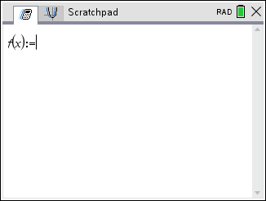
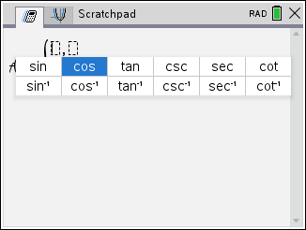
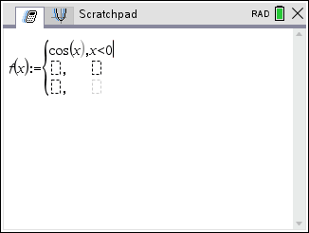
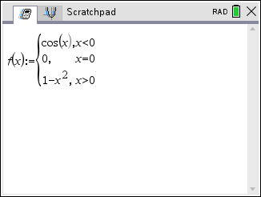
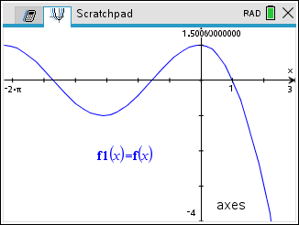
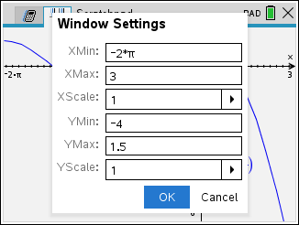
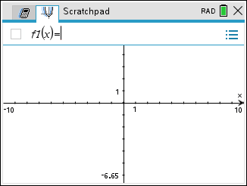


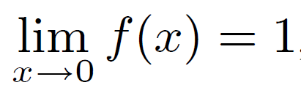
Example
Explain why the function below is discontinuous at the given number a. Sketch the graph of the function.
Solution
3.
But
So, f is not continuous at a = 0.
1.
2.
then
exists

Slide 8
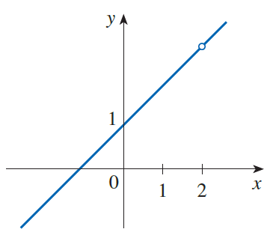
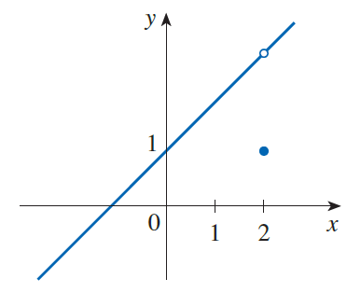
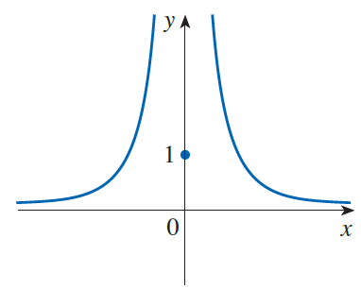
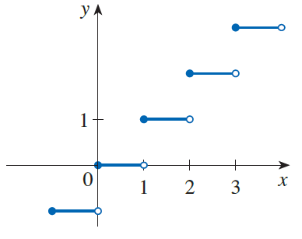
Types of Discontinuities
An undefined discontinuity
A removable discontinuity
An infinite discontinuity
A jump discontinuities

Slide 9
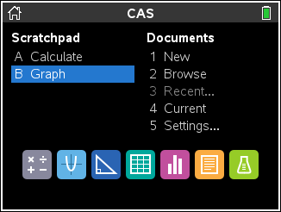
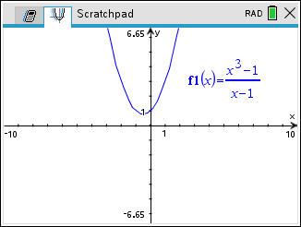
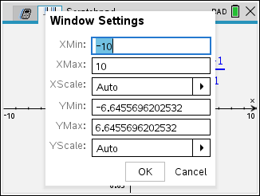
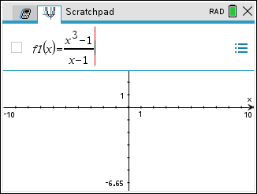
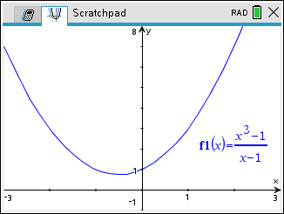
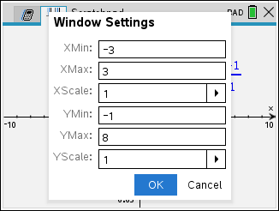
Example
Consider the function
(a) Show that f has an undefined discontinuity at x = 1 (a hole in the graph).
(b) Redefine f (x) as a piecewise function so that f is continuous at x = 1 (and thus “remove” the undefined discontinuity).
Solution

Slide 10
(b) Redefine f (x) as a piecewise function so that f is continuous at x = 1 (and thus “remove” the undefined discontinuity).
Solution
Take x = 1, it follows
Hence, by definition f is continuous at x = 1.

Slide 11
Fixable Discontinuities
An undefined discontinuity
A removable discontinuity
Non-fixable Discontinuities
An infinite discontinuity
A jump discontinuities

Slide 12
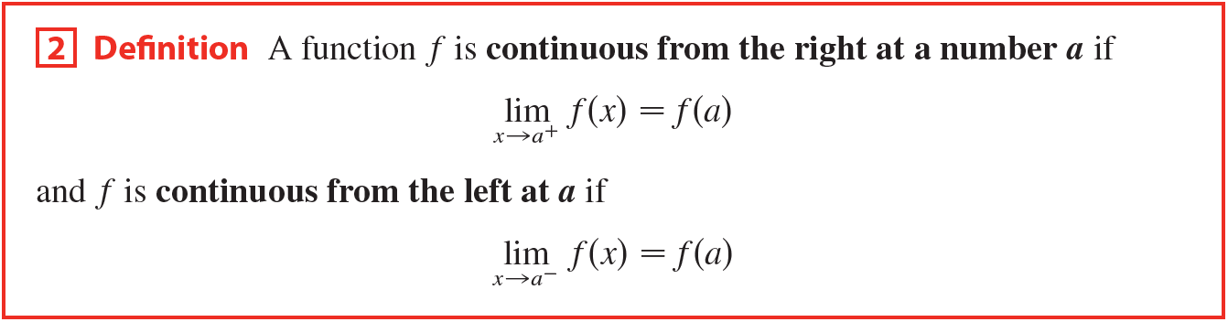

Slide 13
Example
For the function below, discuss the integer values where y = f (x) is
continuous and explain.
Take x = 0, since
y = f (x)
2
1
1
2
3
4
Hence, by definition f is continuous from the right at x = 0.
Sometimes called right-continuous.
Solution
It is continuous at x = 0, x = 3 and x = 4.

Slide 14
Example
For the function below, discuss the integer values where y = f (x) is
continuous and explain.
Take x = 3, since
y = f (x)
2
1
1
2
3
4
Hence, by definition f is continuous at x = 3.
Solution
It is continuous at x = 0, x = 3 and x = 4.

Slide 15
Example
For the function below, discuss the integer values where y = f (x) is
continuous and explain.
Take x = 4, since
y = f (x)
2
1
1
2
3
4
Hence, by definition f is continuous from the left at x = 4.
Sometimes called left-continuous.
Solution
It is continuous at x = 0, x = 3 and x = 4.

Slide 16
Example
For the function below, discuss the integer values where y = f (x) is
not continuous and explain.
Take x = 1, since
y = f (x)
2
1
1
2
3
4
Hence, by definition f is discontinuous at x = 1.
Solution
It is not continuous at x = 1 and x = 2.

Slide 17
Example
For the function below, discuss the integer values where y = f (x) is
not continuous and explain.
Take x = 2, since
y = f (x)
2
1
1
2
3
4
Hence, by definition f is discontinuous at x = 2.
Solution
Determine the intervals where
y = f (x) is continuous.
It is not continuous at x = 1 and x = 2.

Slide 18
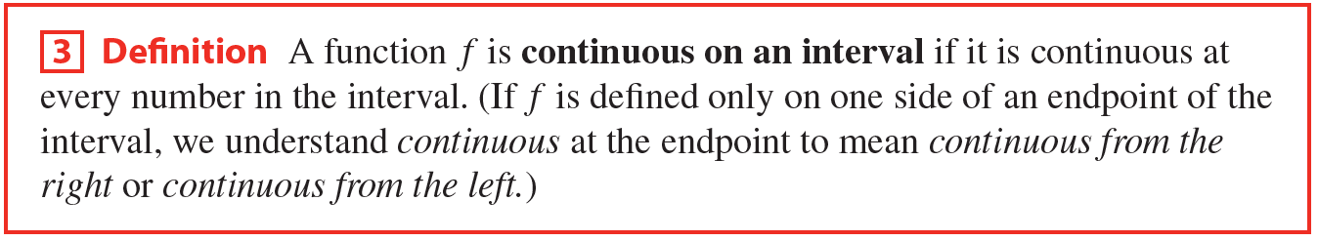

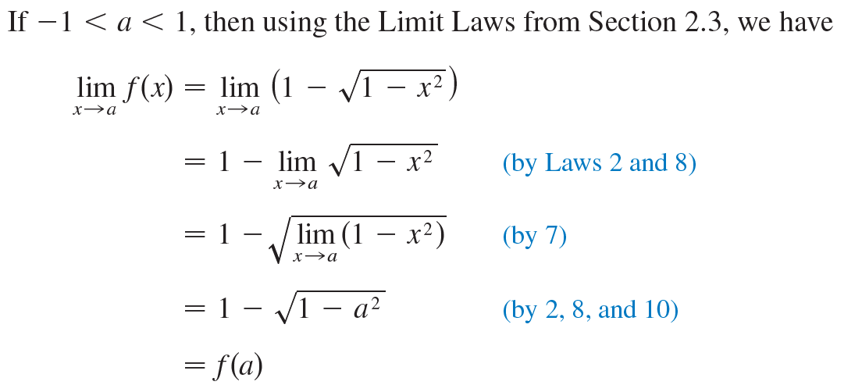
Example
Solution

Slide 19
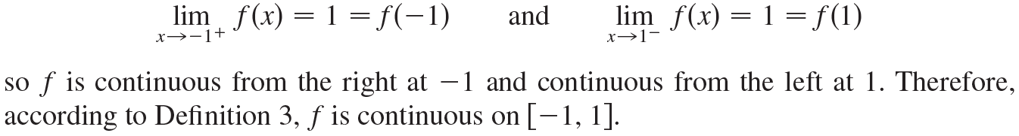
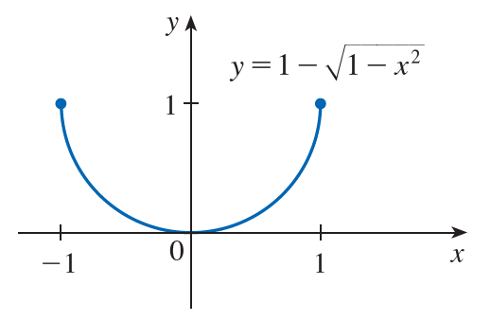
Example
Solution
For the endpoints x = −1 and x = 1, similar calculations show that

Slide 20
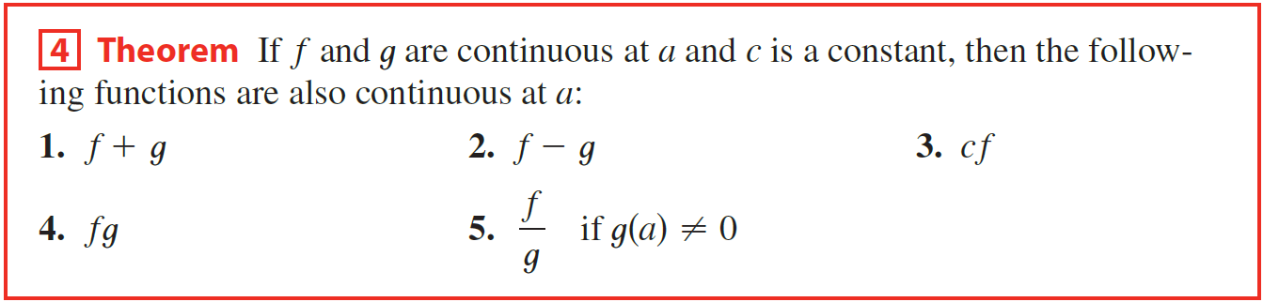
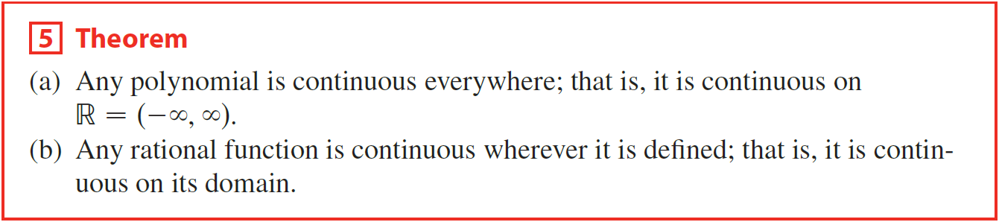
Some convenient theorems, which shows how to build up complicated continuous functions from simple ones.

Slide 21
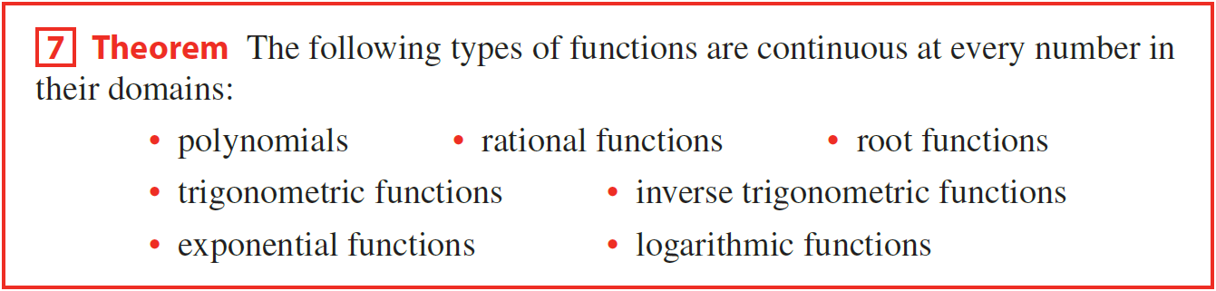
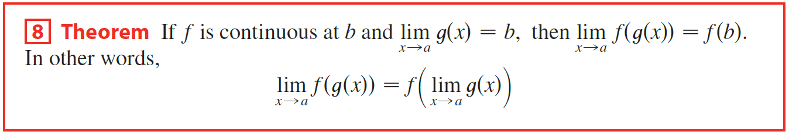

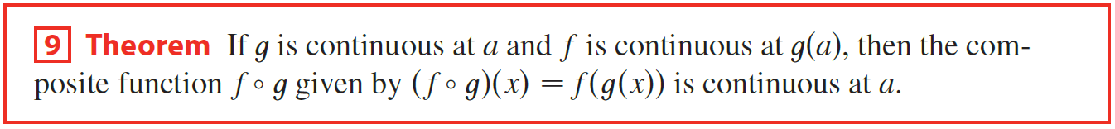
Let’s look at some examples.

Slide 22






Example
Explain, using Theorems 4, 5, 7, and 9, why the function below is continuous at every number in its domain. State the domain.
Solution
Thus, L(v) has domain v $∈$(−1, 1).

Slide 24
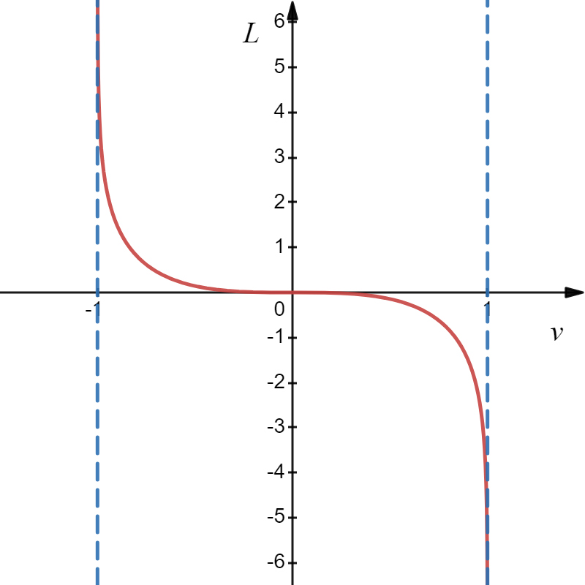
Example
Explain, using Theorems 4, 5, 7, and 9, why the function below is continuous at every number in its domain. State the domain.
Solution
v = −1
v = 1
Thus, L(v) has domain v $∈$(−1, 1).
What happens to the function at $x=−1$and $x=1$?

Slide 25


Example
Solution

Slide 26


Example
Find the values of a and b that make f continuous everywhere.
Solution

Slide 27












Example
Find the values of a and b that make f continuous everywhere.
Solution
System of Equations

Slide 28





Slide 29



Example
Use the Intermediate Value Theorem to show that there is a solution of the given equation below in the specified interval.
Solution

