Slide 1
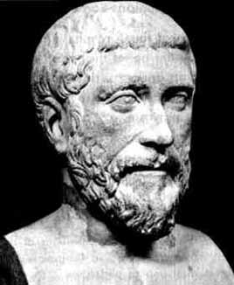
Pythagoras of Samos
580 – 500 B.C.
Pythagoras was a Greek philosopher who made important developments in mathematics, astronomy, and the theory of music. The theorem now known as Pythagoras's theorem was known to the Babylonians 1000 years earlier, but he may have been the first to prove it.

Slide 2
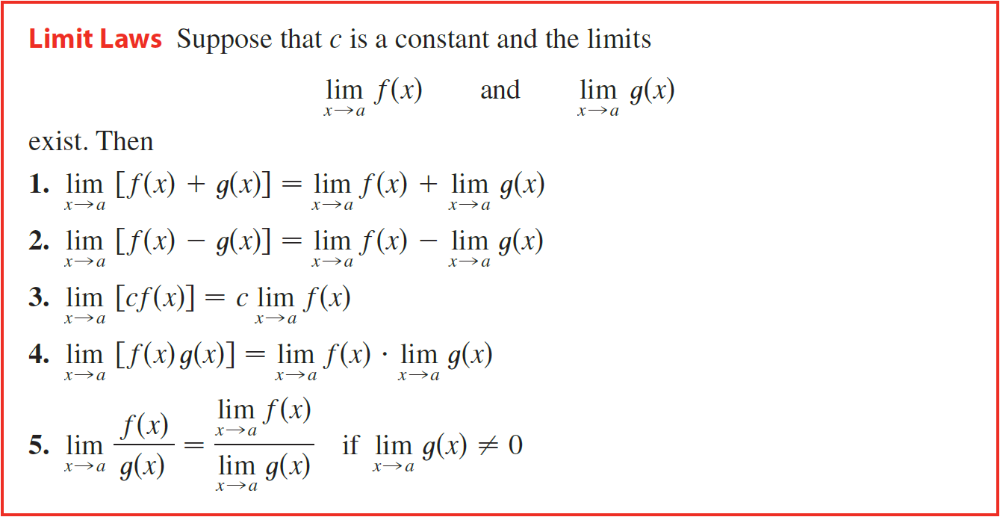

In Section 2.2 we used calculators and graphs to guess the values of limits, but such methods don’t always lead to the correct answers. In this section we use the following theorems of limits, called the Limit Laws, to calculate limits. Sometimes called analytic limits.

Slide 3
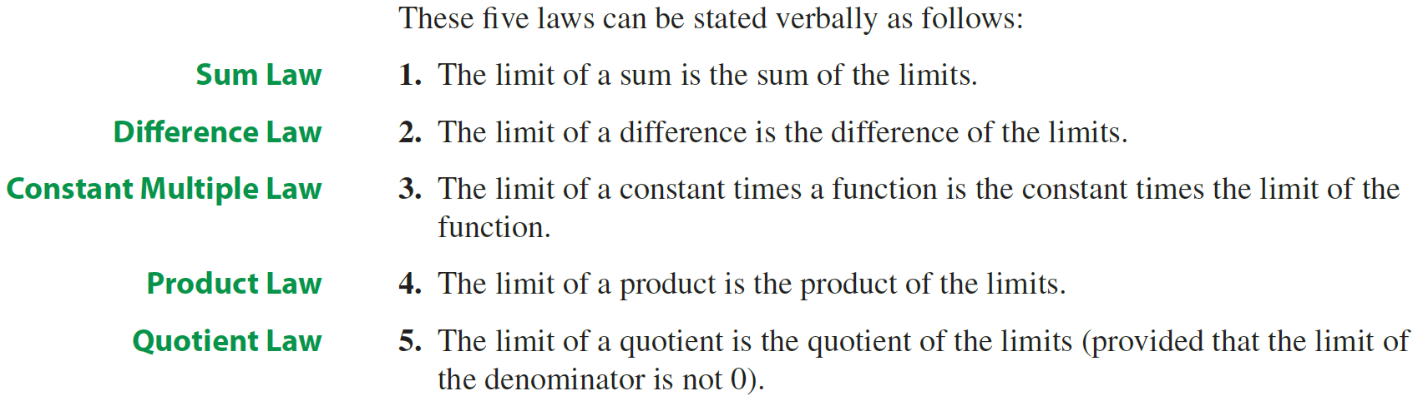

Slide 4
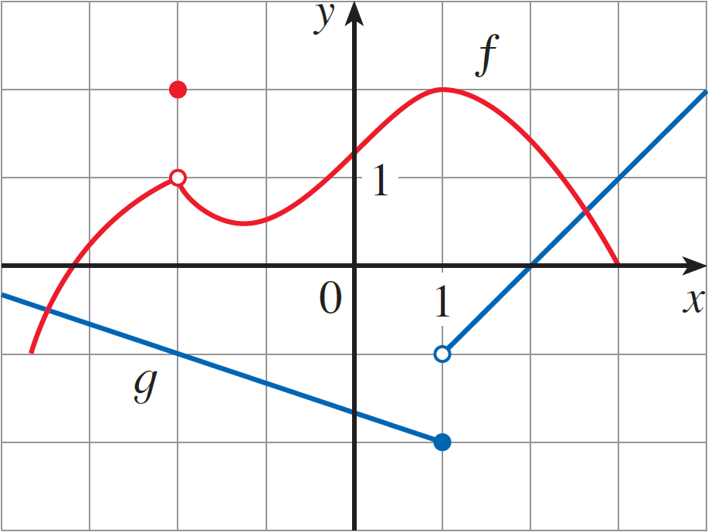
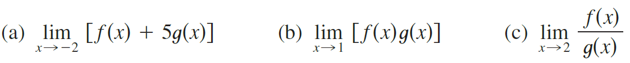
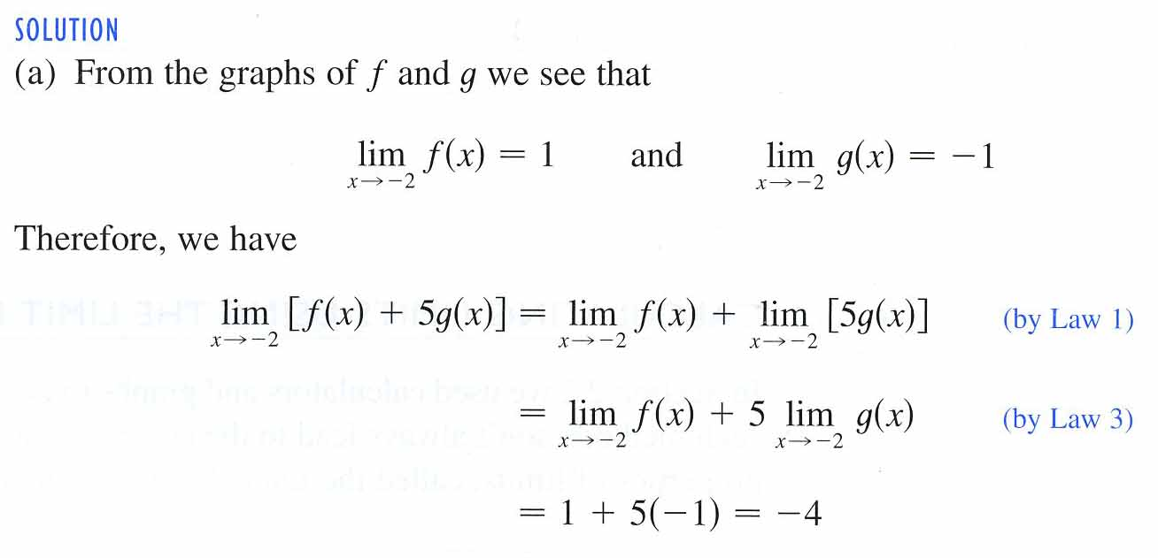
Example
Use the Limit Laws and the graphs of f and t in the figure 1 to evaluate the following limits, if they exist.
Solution

Slide 5
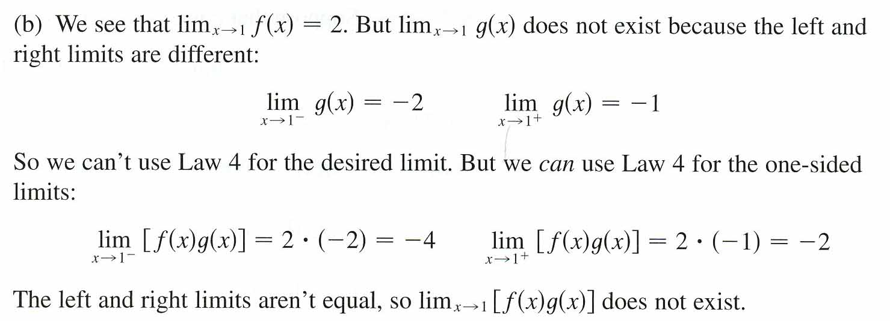
Example
Use the Limit Laws and the graphs of f and t in the figure 1 to evaluate the following limits, if they exist.
Solution

Slide 6
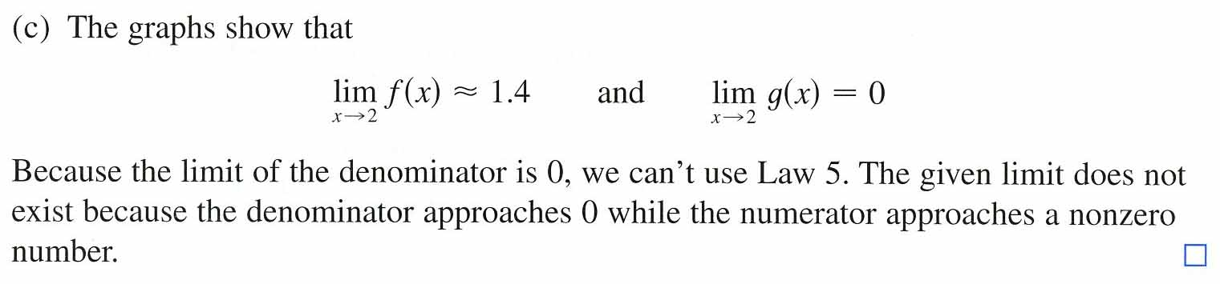
Example
Use the Limit Laws and the graphs of f and t in the figure 1 to evaluate the following limits, if they exist.
Solution

Slide 7

A similar property holds for roots:
In applying these seven limit laws, we need to use two special limits:

Slide 8
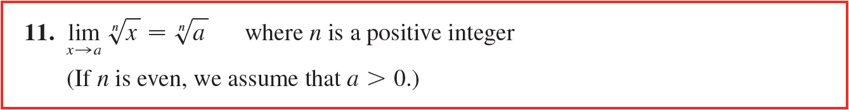
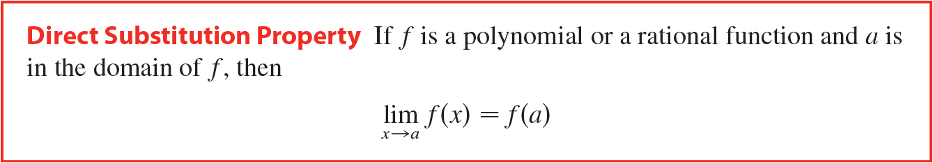

Slide 9

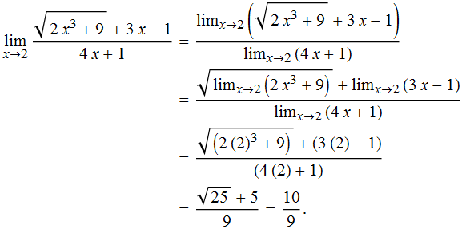

Example
Solution
Limit Law 5
Limit Laws 1 and 7
Direct Substitution
Simplifying
The function in the Example above is made up with polynomials, the use of the Limit Laws proves that direct substitution always works for such functions. We state this fact as follows.

Slide 10
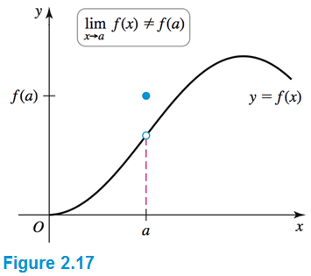
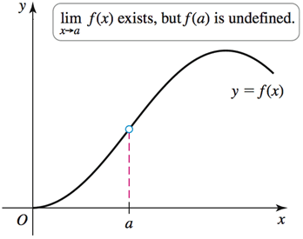
Functions that have the Direct Substitution Property are called continuous at a and will be studied in Section 2.5. However, not all limits can be evaluated initially by direct substitution, as the following examples show.
L
L

Slide 11
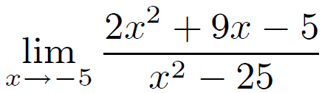
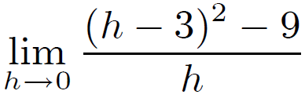
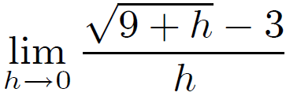
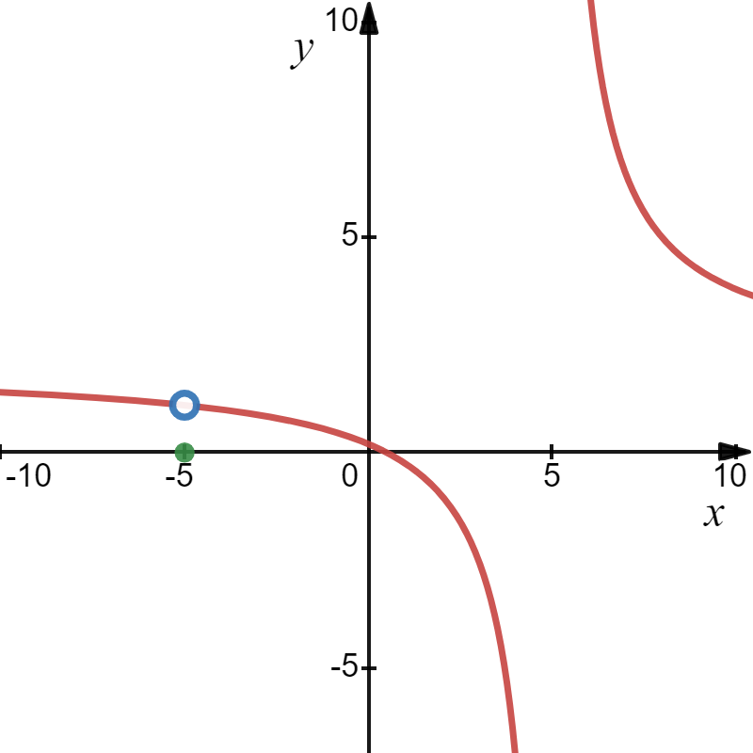
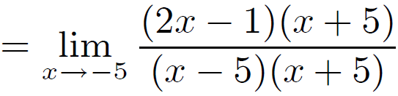
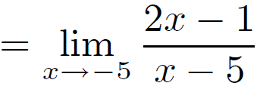
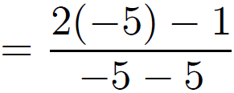
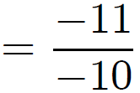
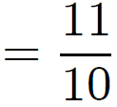
Example
Evaluate the limit, if it exists. Describe what functional behavior occurs at the limit point.
(b)
(c)
(a)
Solution
(a)
Direct Substitution

Slide 12
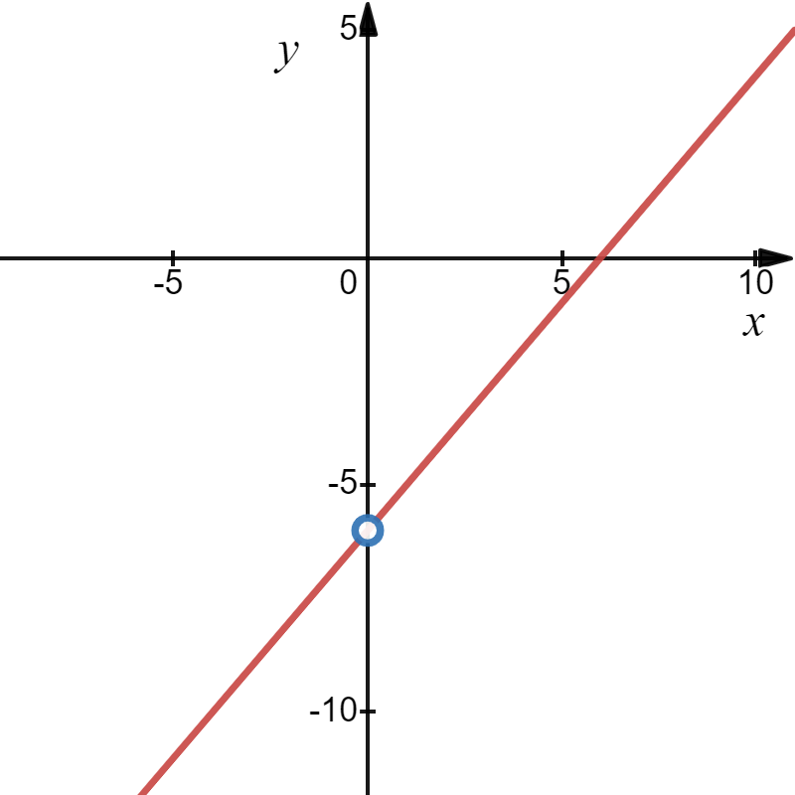
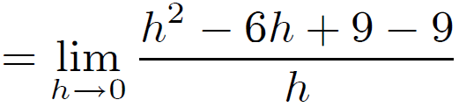
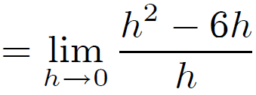
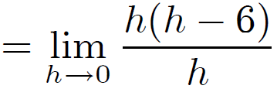



Example
Evaluate the limit, if it exists. Describe what functional behavior occurs at the limit point.
(b)
(c)
(a)
Solution
(b)
Direct Substitution

Slide 13
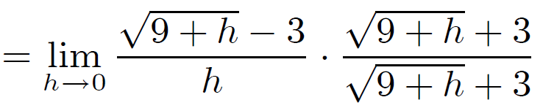
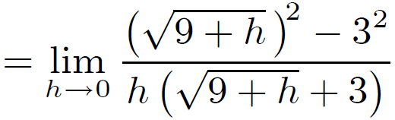
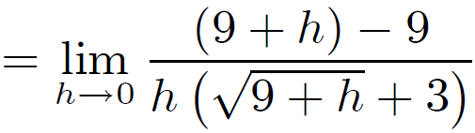
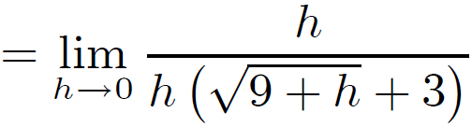
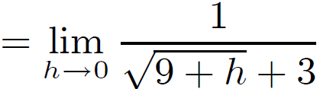
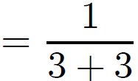

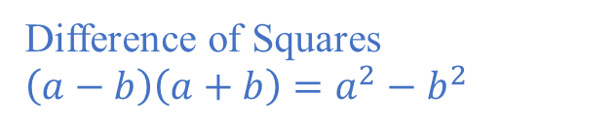
Example
Evaluate the limit, if it exists. Describe what functional behavior occurs at the limit point.
(b)
(c)
(a)
Solution
(c)
Clever form of 1
Difference of Squares
$$\left(a−b\right)\left(a+b\right)=a^{2}−b^{2}$$
Direct Substitution

Slide 14

Some limits are best calculated by first finding the left- and right-hand limits. The following theorem is a reminder of what we discovered in Section 2.2. It says that a two-sided limit exists if and only if both of the one-sided limits exist and are equal.
When computing one-sided limits, we use the fact that the Limit Laws also hold for one-sided limits.

Slide 15

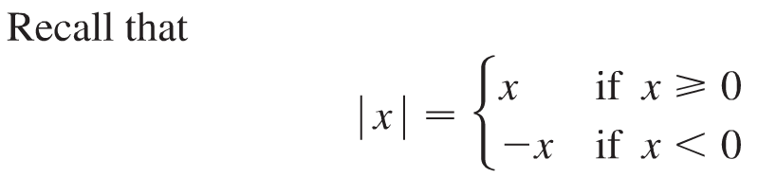

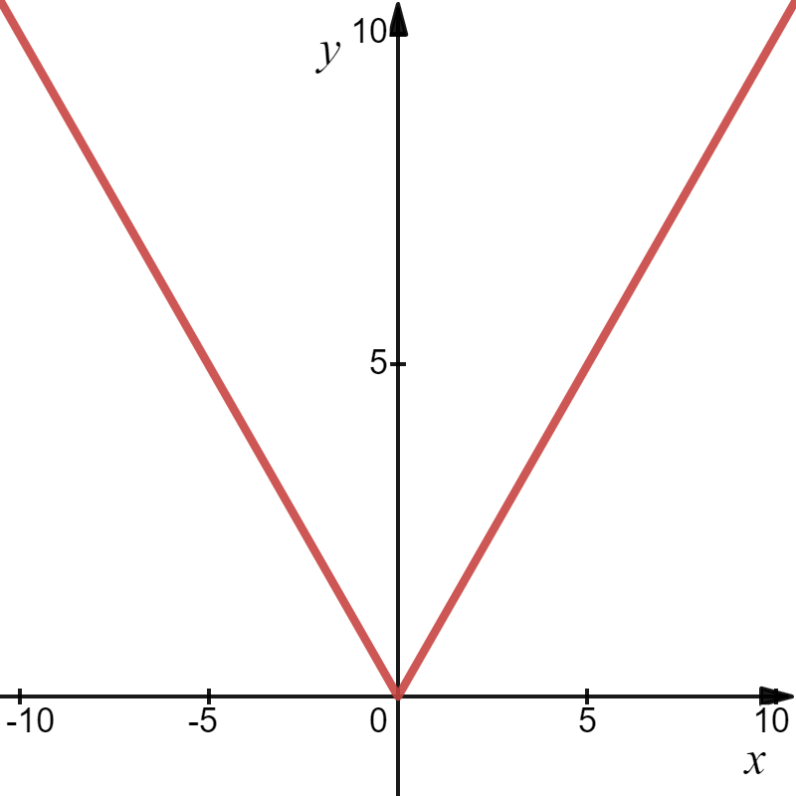
Example
Solution

Slide 16
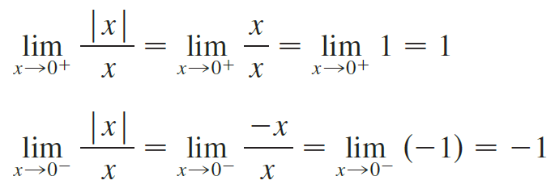
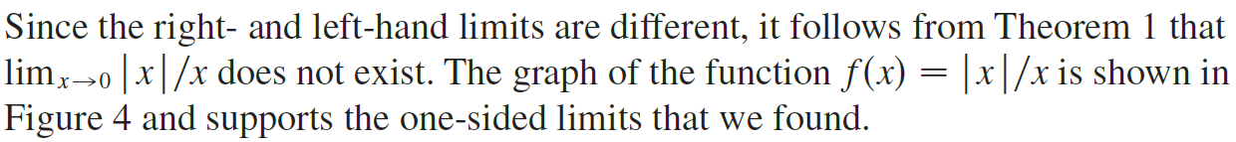
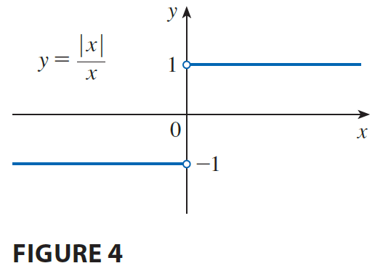
Example
Solution

Slide 17

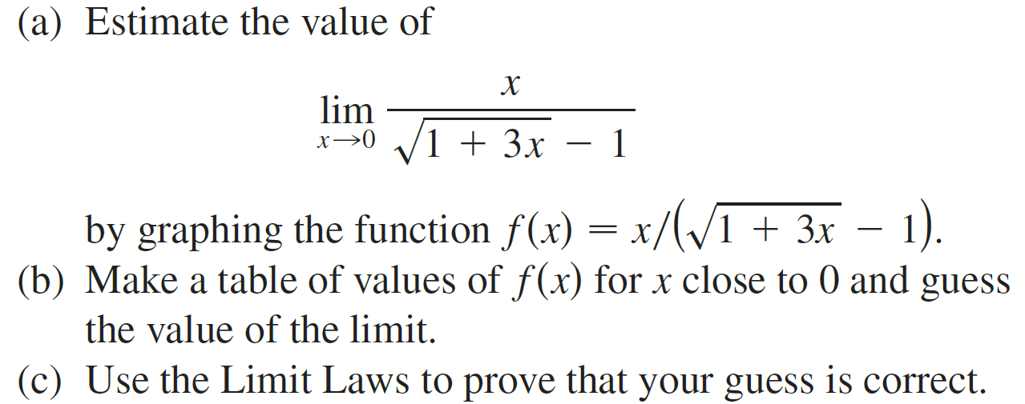
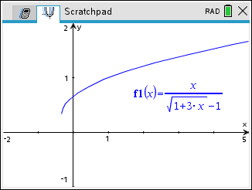
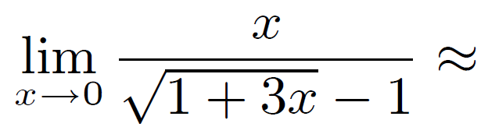
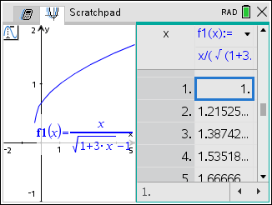
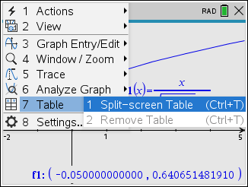
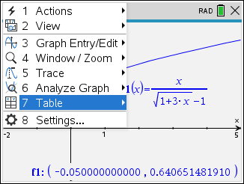
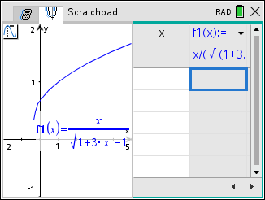
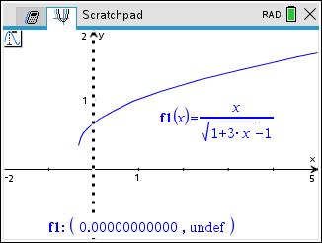
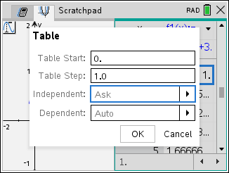
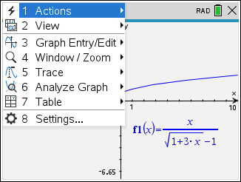
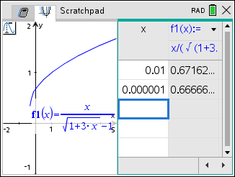
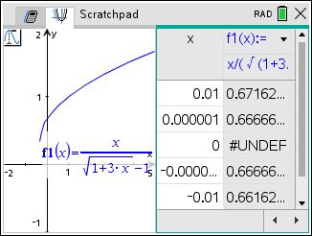






















Example
Solution
(a)
0.665
(b)
0.667

Slide 18





















Example
Solution
(c)
=

Slide 19










Greatest Integer Function
Example
Floor Function
Solution
y
x
y =
Also known as the greatest integer function .
$$⟦−2.6⟧=−3$$

Slide 20






Example
Find the limit, if it exists. If the limit does not exist, explain why.
Solution
which does not exist since the denominator approaches 0 and the numerator does not. We will talk more about this later.

Slide 21





































Example
Find the limit, if it exists. If the limit does not exist, explain why.
Solution

Slide 22






Example
Find the limit, if it exists. If the limit does not exist, explain why.
Solution

Slide 23



Recall the following definitions from 2.2

Slide 24




Slide 25








Slide 26


Numerator going to a nonzero constant.
Denominator going to zero.
Sign Test

Slide 27



Limit Theorems at Infinity
$$y=f(x)$$
Sign Test
Sign Test

Slide 28


Limit Theorems at Infinity
$$y=f(x)$$
Sign Test
Sign Test

Slide 29

Example
Evaluate the limits below. What does each this limit tell us about the functional behavior of f (x)?
Solution
Sign Test
The function has a vertical asymptote at x = −2.

Slide 30
Example
Evaluate the limits below. What does this limit tell us about the functional behavior of f (x)?
Solution
Sign Test
The function has a vertical asymptote at x = 0.

Slide 31

Example
Evaluate the limits below. What does this limit tell us about the functional behavior of f (x)?
Solution
$$\left(2,−\frac{1}{8}\right)$$
The function has a hole in the graph at $\left(2,−\frac{1}{8}\right)$.

Slide 32



The following two theorems describe how the limits of functions are related when the values of one function are greater than (or equal to) those of another.

Slide 33


The Squeeze Theorem, sometimes called the Sandwich Theorem or the Pinching Theorem.

Slide 34
Example
Solution

Slide 35


















Hence, by the Squeeze Theorem

