Slide 1
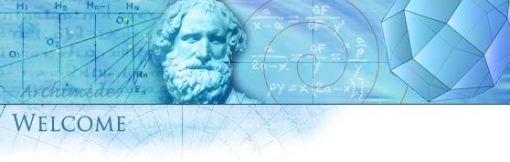
Santa Rosa Junior College
Mathematics
Gale Bach
First Course in Calculus
Math 1A - 8380
Summer 2026
In Da Club
Syllabus
http://profiles.santarosa.edu/gale-w-bach

Slide 2

Why Math?
Math Solves Problems!

Slide 3
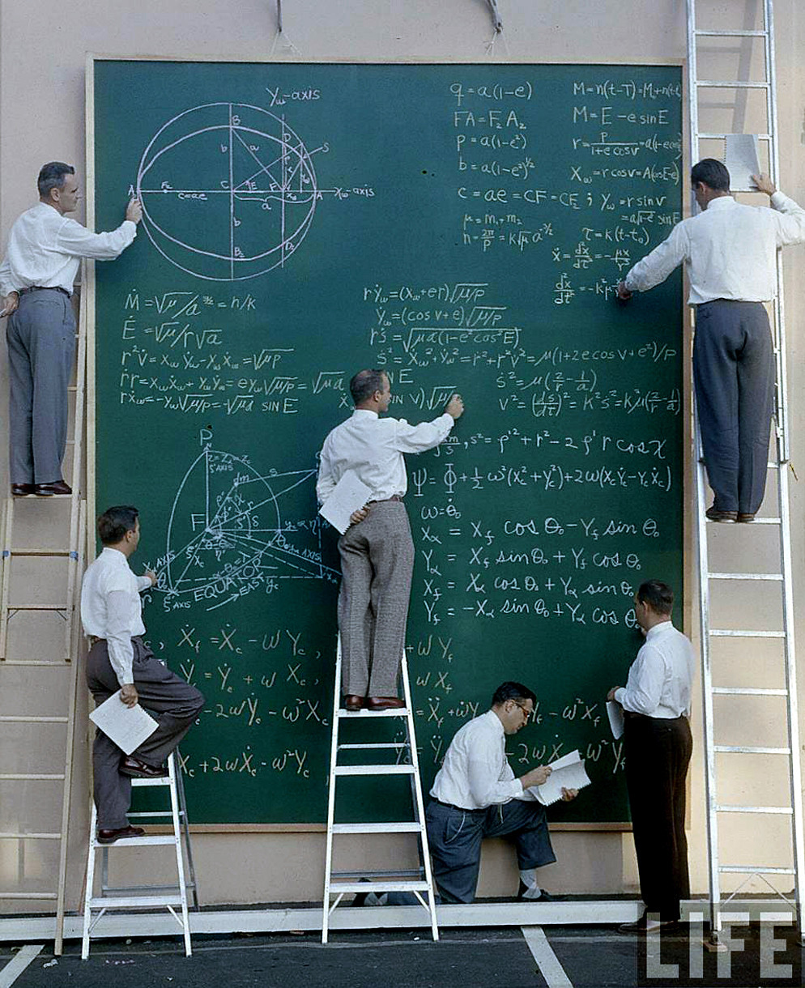
What is Math?

Slide 4
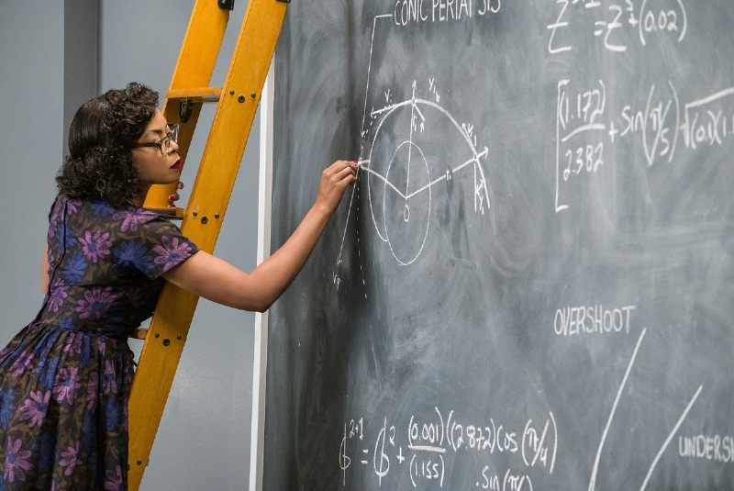
What is Math?

Slide 5
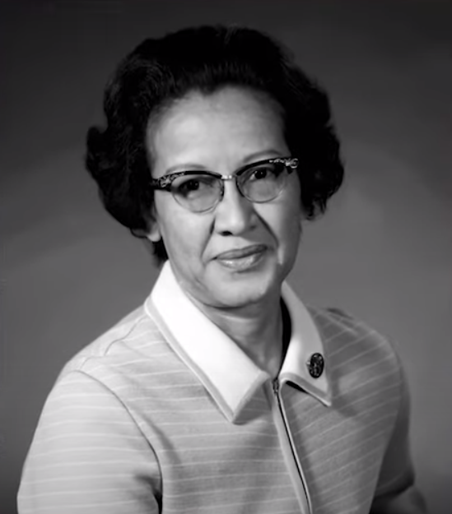
Katherine Johnson (August 26, 1918 – February 24, 2020) was an American mathematician whose calculations of orbital mechanics as a NASA employee were critical to the success of the first and subsequent U.S. crewed spaceflights. During her 35-year career at NASA and its predecessor, she earned a reputation for mastering complex manual calculations and helped pioneer the use of computers to perform the tasks. The space agency noted her "historical role as one of the first African American women to work as a NASA scientist". NASA has renamed its Independent Verification and Validation Facility in Fairmont, West Virginia, as the Katherine Johnson Independent Verification and Validation Facility, in honor of the West Virginia native.

Slide 6


We know that when an object is dropped from a height it falls faster and faster. Galileo discovered that the distance the object has fallen is proportional to the square of the time elapsed. Calculus enables us to calculate the precise speed of the object at any time. In Exercise 2.7.11 you are asked to determine the speed at which a cliff diver plunges into the ocean.

Slide 7
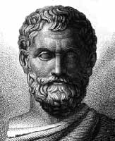
The Ancients
A circle is bisected by any diameter.
The base angles of an isosceles triangle are equal.
The angles between two intersecting straight lines are equal.
Two triangles are congruent if they have two angles and one side equal.
An angle in a semicircle is a right angle.
Thales of Miletus
625 – 547 B.C.
Thales was the first known Greek philosopher, scientist and mathematician. He is credited with five theorems of elementary geometry.

Slide 8
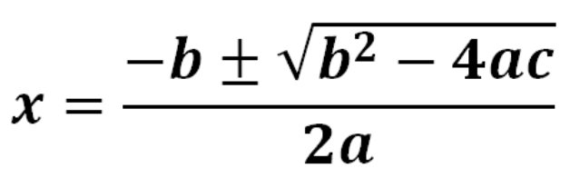
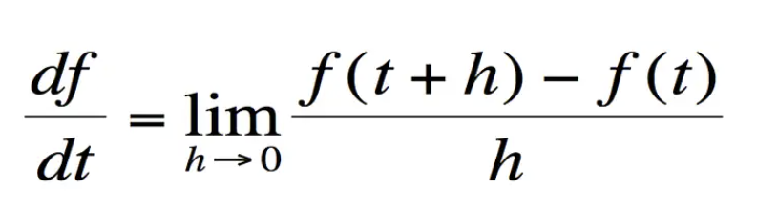
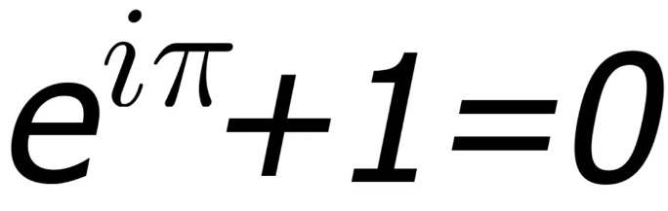
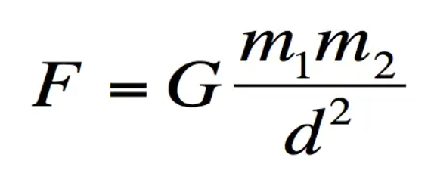
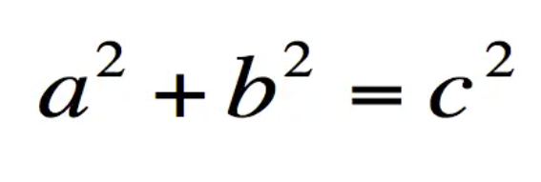
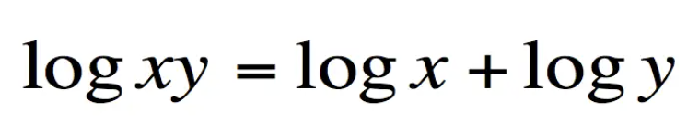
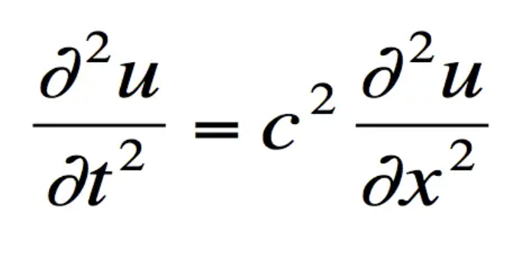
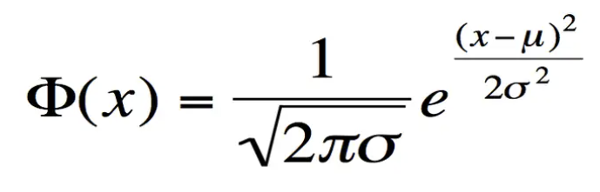
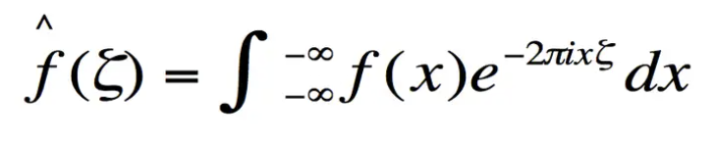
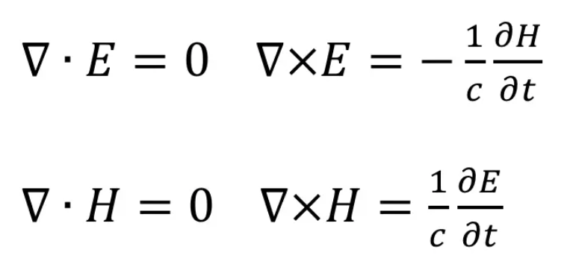
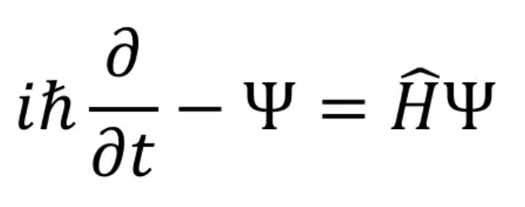
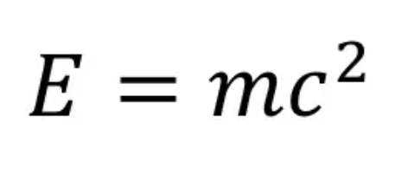

Slide 10
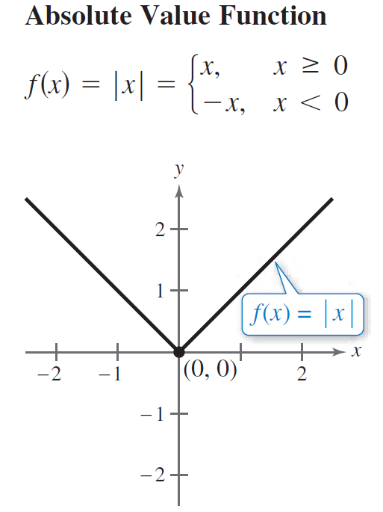
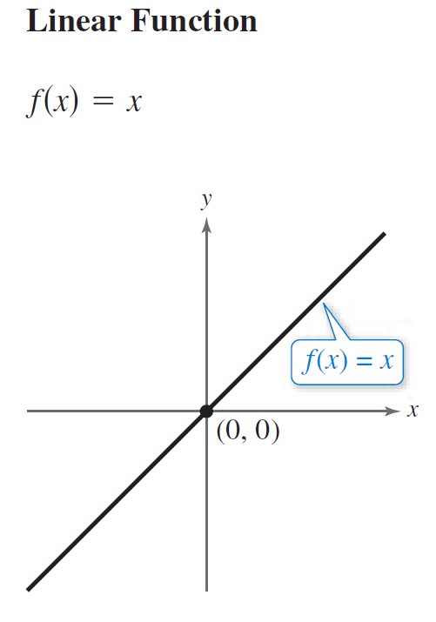
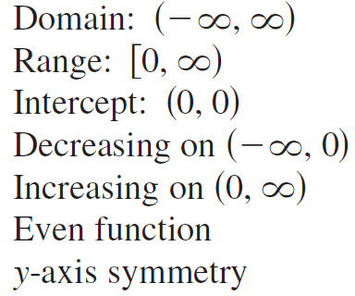

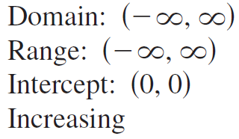
Library of Parent Functions Summary

Slide 11
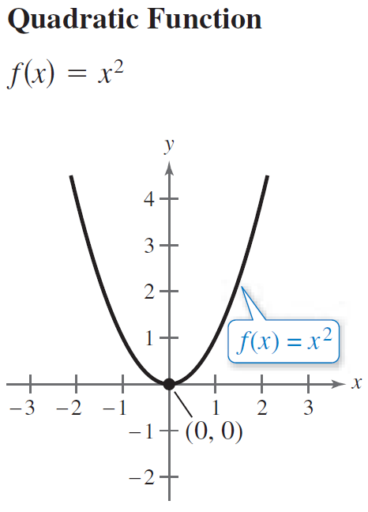
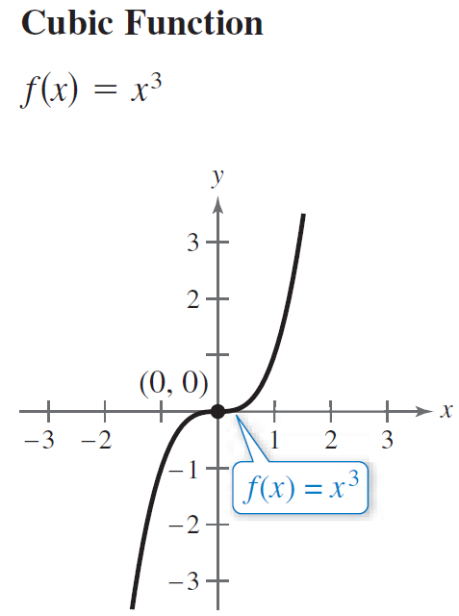
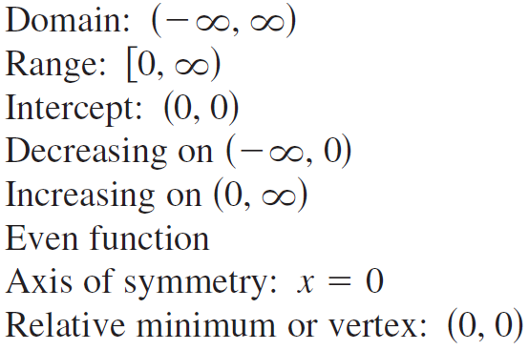
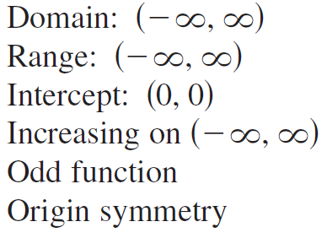

Slide 12
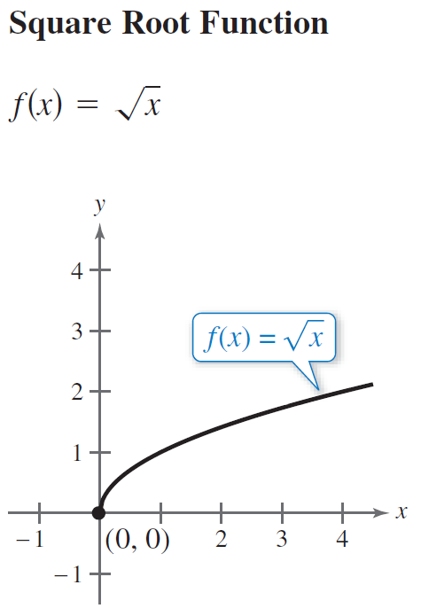
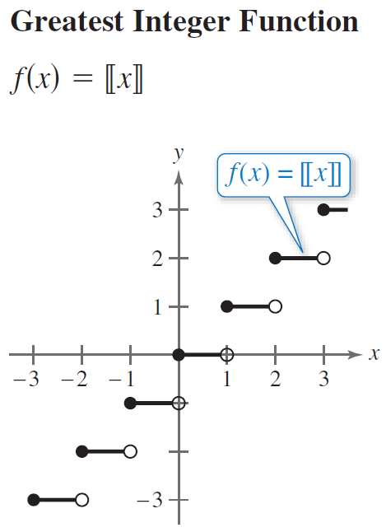
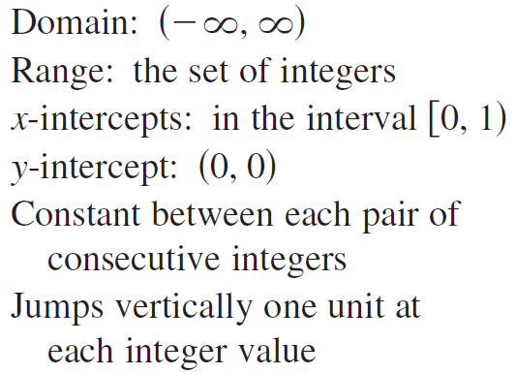
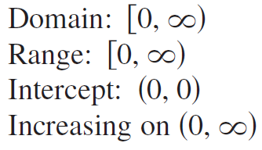

Slide 13
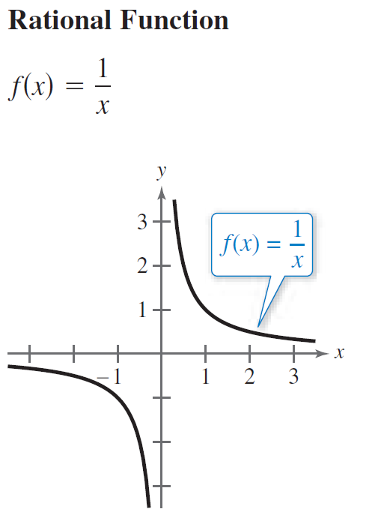
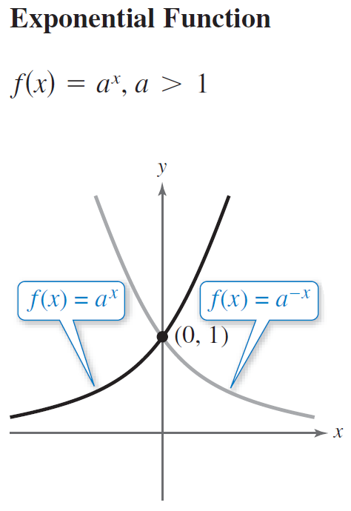
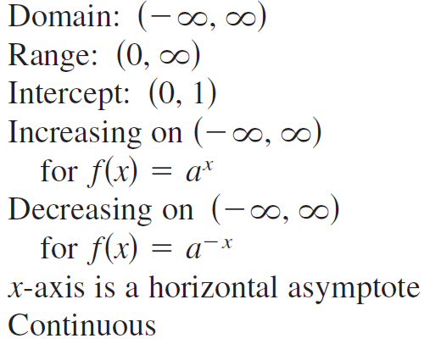
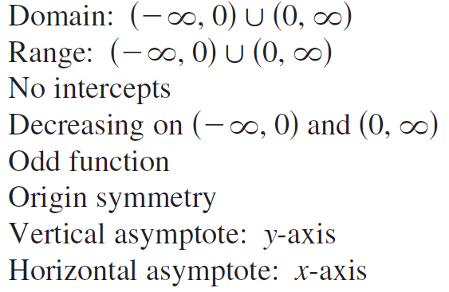

Slide 14
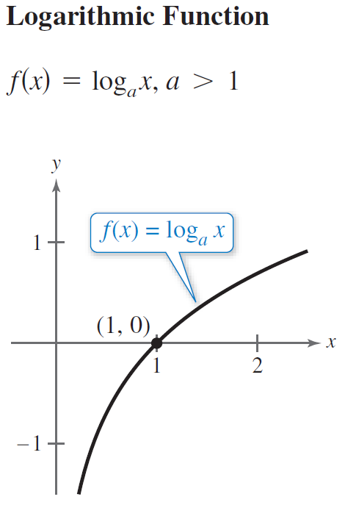
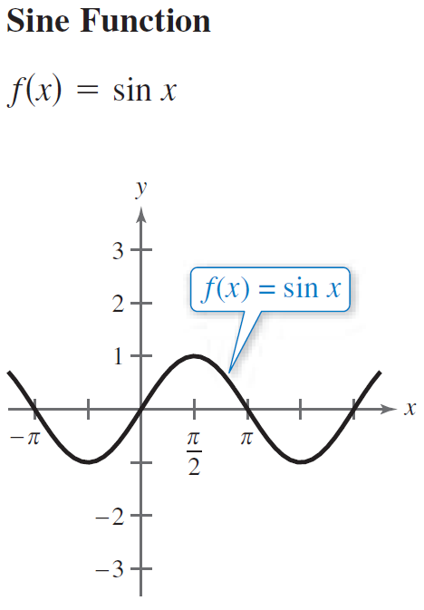
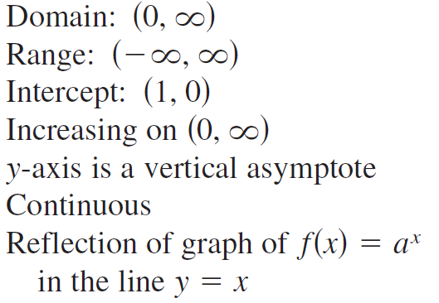
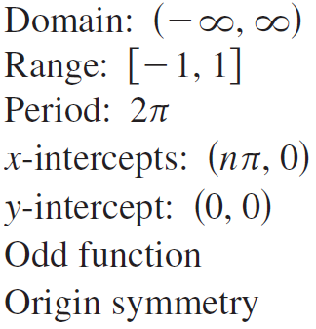


Slide 15
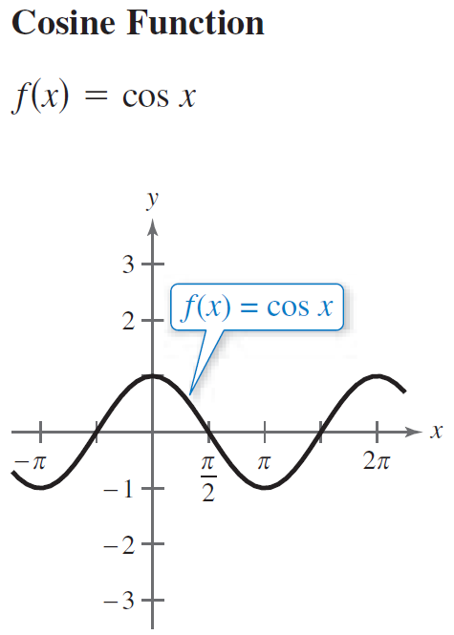
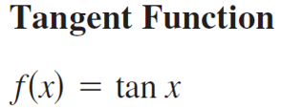
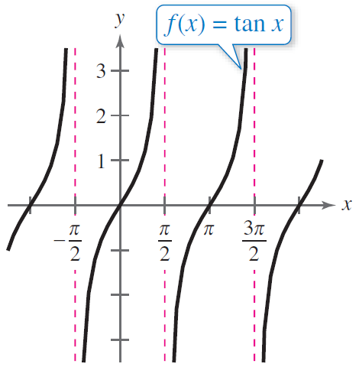
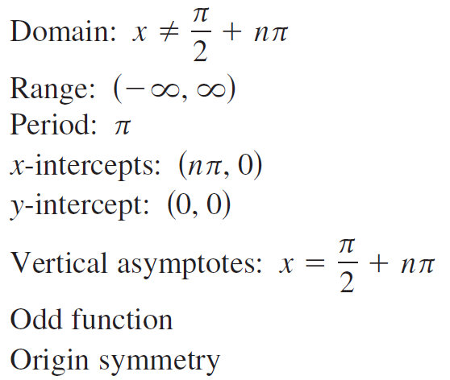
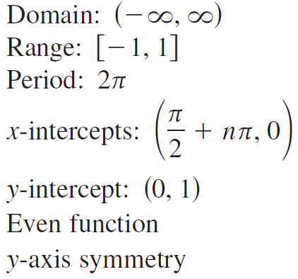

Slide 16
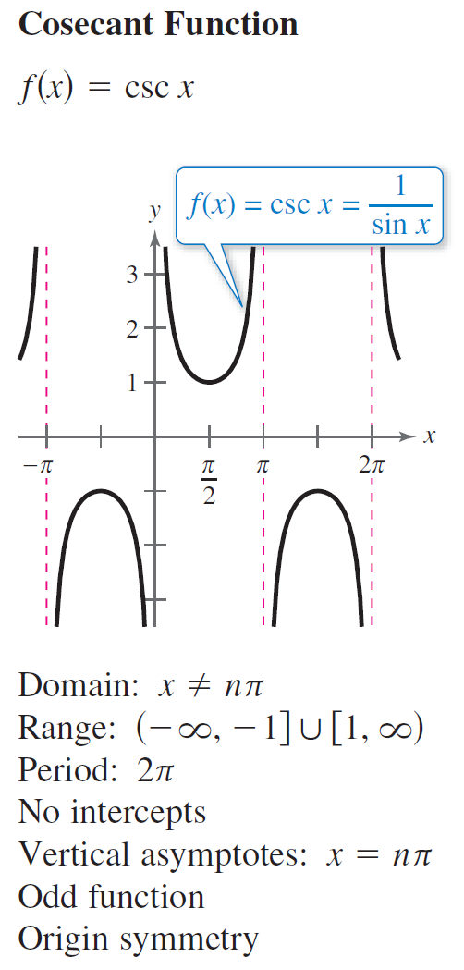
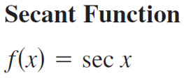
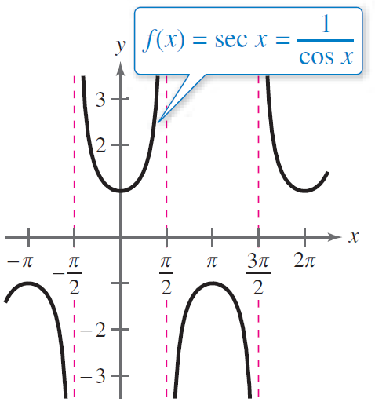
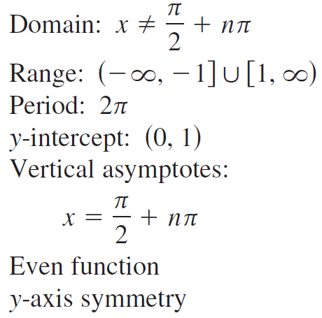

Slide 17
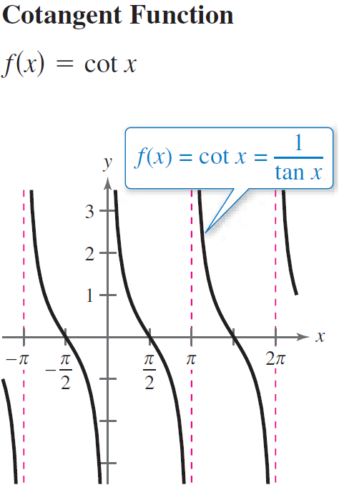
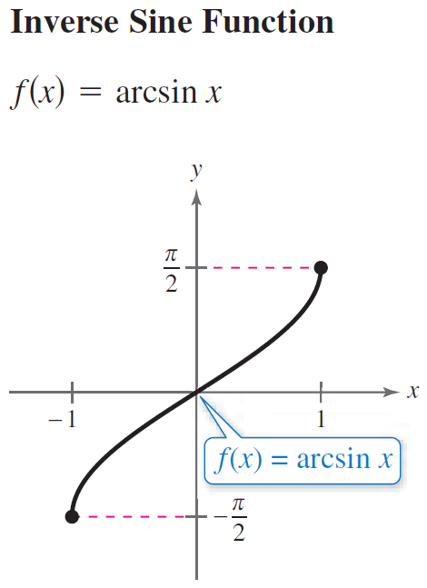
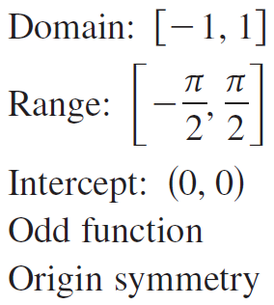
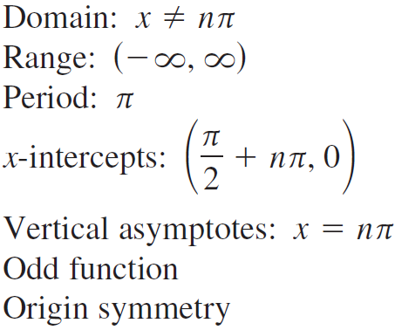

Slide 18




Slide 19
Example
As x approaches 2, what is the behavior of f (x)?
Solution
There will be three strategies for analyzing this question.
1.) Graphically
2.) Numerically
3.) Algebraically/Symbolically
In section 2.2, our analysis will be graphical and numerical, the warm and fuzzy way!

Slide 20



Slide 21


The limit of a function refers to the value that the function approaches, not the actual value (if any).
Example
Solution

Slide 22



The figure below shows the graphs of three functions.

Slide 23


































Example
Solution
Hole in the graph
(0, 1)

Slide 24

Example
Solution
Limit from the left
From the left
Limit from the right
From the right
These are called one-sided
or directional limits.

Slide 25




Slide 26
Non-directional limit
Directional limits
or
One-sided limits

Slide 27
Example
Solution
does not exist
because the left and right hand limits are not equal!
2
1
1
2
3
4
Interior points a = 1, a = 2, and a = 3.
At a = 1:
left hand limit
right hand limit
value of the function

Slide 28
Example
Solution
2
because the left and right hand limits are equal.
1
1
2
3
4
Interior points a = 1, a = 2, and a = 3.
At a = 2:
left hand limit
right hand limit
value of the function

Slide 29
Example
Solution
2
because the left and right hand limits are equal.
1
1
2
3
4
Interior points a = 1, a = 2, and a = 3.
All three are equal! I wonder if
that is something special?
At a = 3:
left hand limit
right hand limit
value of the function

Slide 30
Example
Solution
2
1
1
2
3
4
Limits at the endpoints a = 0 and a = 4.
At a = 0:
right hand limit
At a = 4:
left hand limit
Limits can only approach through domain values.

Slide 31

















Example
Solution

Slide 32






















Example
Sketch the graph of the function and use it to determine the values from the domain for which the limit exists.
We need to check a = 0 and a = $π$.
At a = 0:
Solution
At a = $π$:
$$π$$

Slide 33


Slide 34




Slide 35



A similar sort of limit, for functions that become large negative as x gets close to a, is defined in Definition 5.

Slide 36








Slide 37

Example
Given the function $y=f(x)$ below, find the given limits and determine any vertical asymptotes.

Slide 38





Example
x = 0
Solution
x
y
Hence, there is a vertical asymptote x = 0.

Slide 39




Example
Solution
(0, 1.609)
Hence, there is a hole (0, 1.609).
= 1.609
= 1.609

