Slide 1
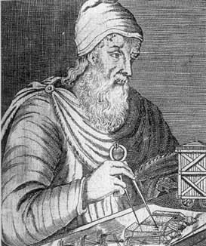
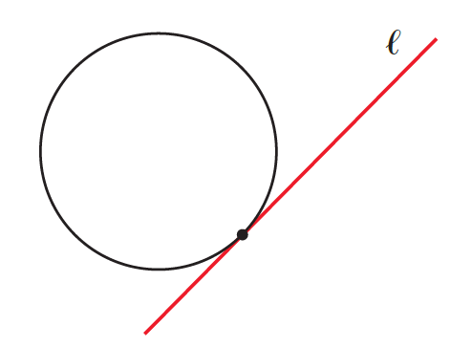
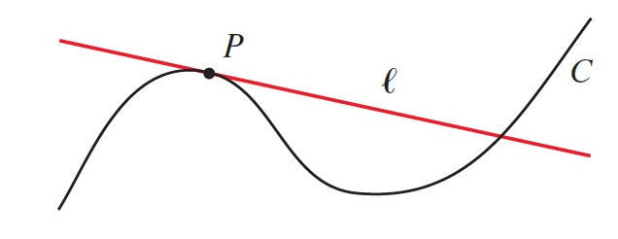
Archimedes of Syracuse
287 – 212 B.C.
Archimedes was the greatest mathematician of his age. His contributions in geometry revolutionized the subject and his methods anticipated the integral calculus 2,000 years before Newton and Leibniz.

Slide 2

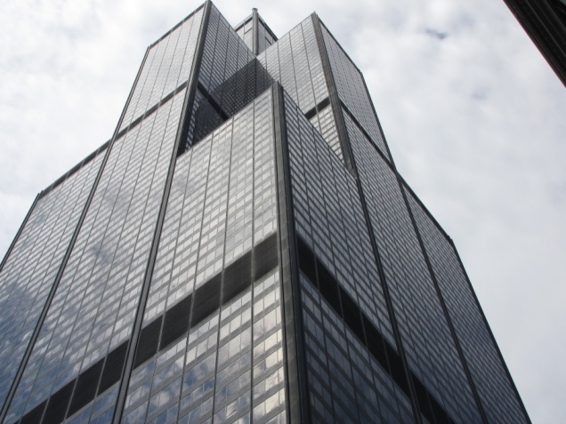
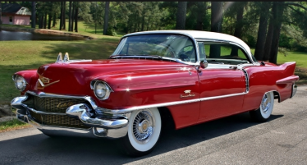
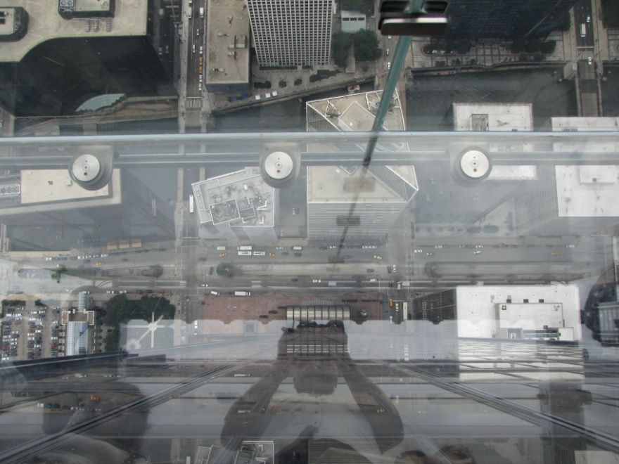
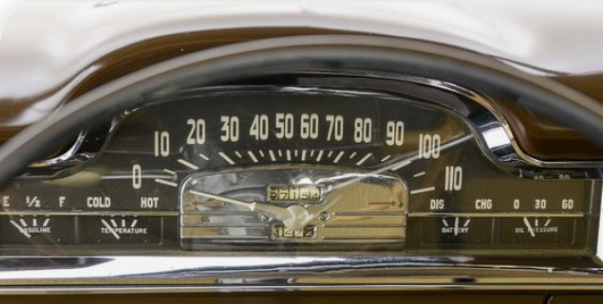
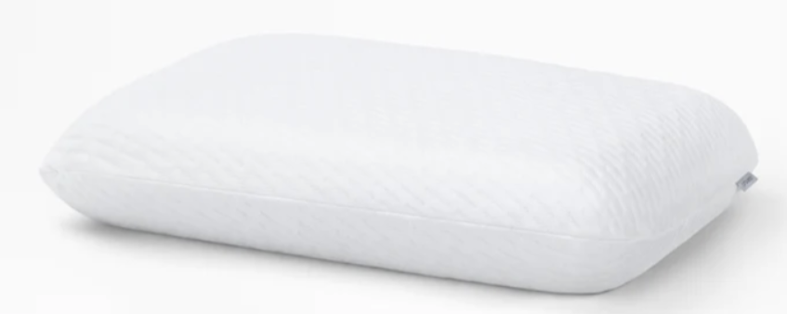
Example
An object is dropped from the top of the Sears building in Chicago. The height of the building is 1450 feet. By Galileo’s law we get function,
Where t is time in seconds, and s(t) is the position of the object above the ground, feet, after t seconds.
(a) Find the average velocity from 2 seconds to 6 seconds.
(b) Find the velocity at 6 seconds.

Slide 3
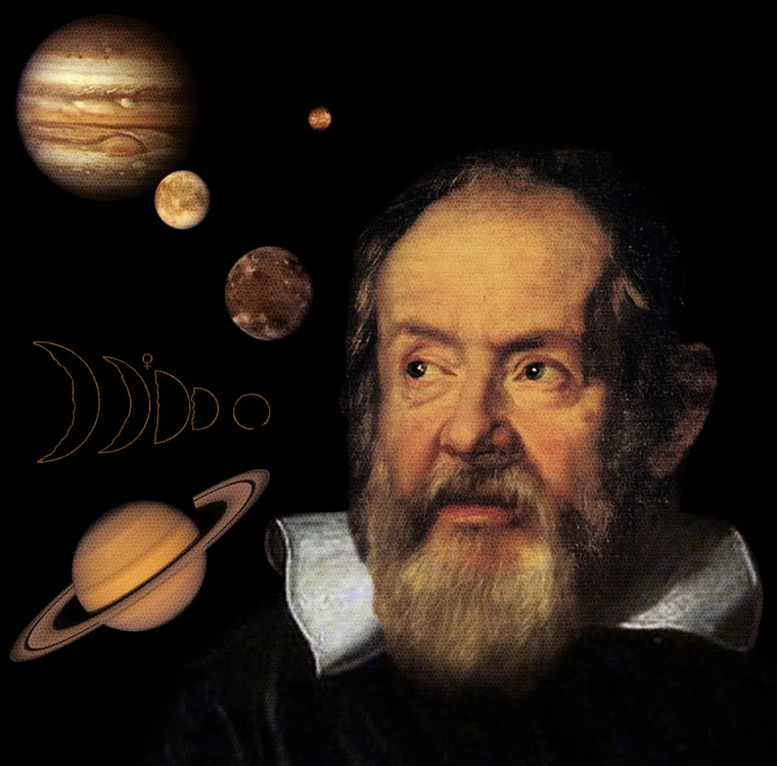
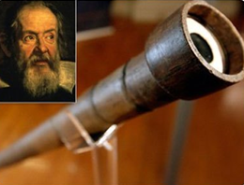
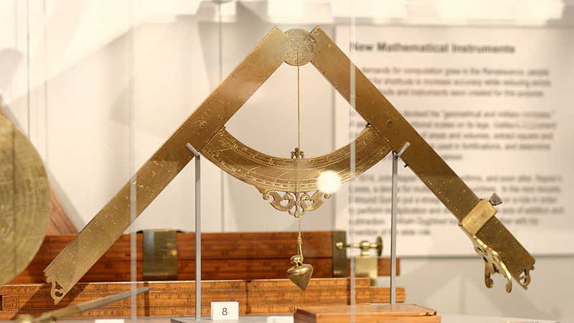
Galileo Galilei
1564 - 1642
Galileo was an Italian scientist who formulated the basic law of falling bodies, which he verified by careful measurements. He constructed a telescope with which he studied lunar craters and discovered four moons revolving around Jupiter and espoused the Copernican cause.
How many moons does Jupiter have?

Slide 4
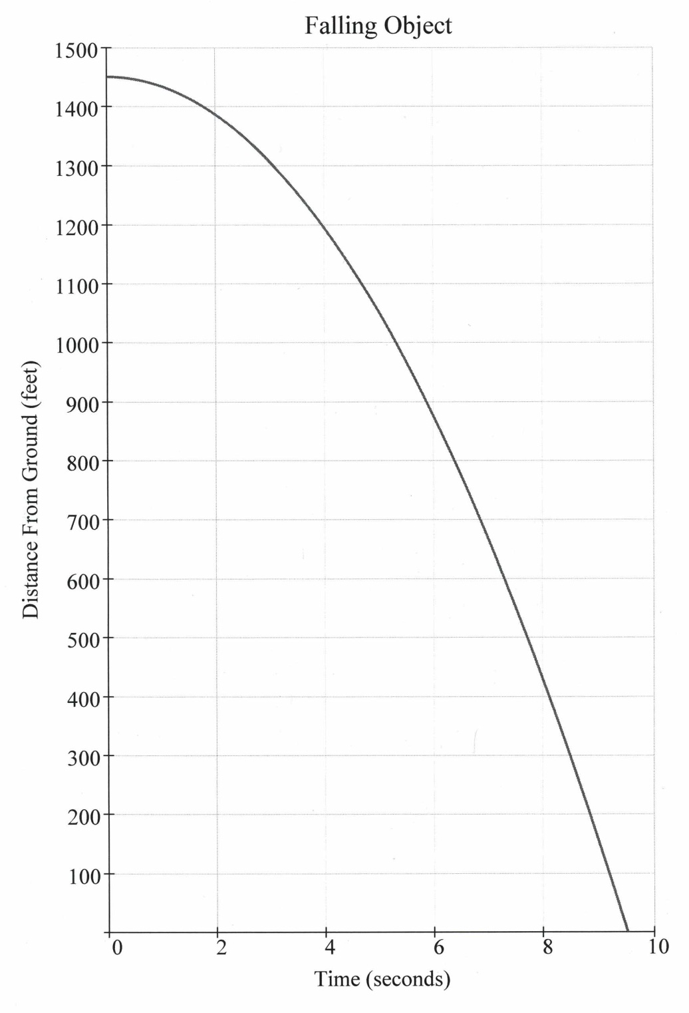
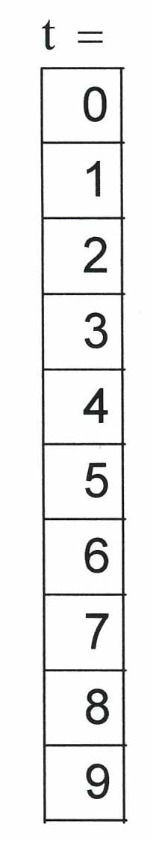
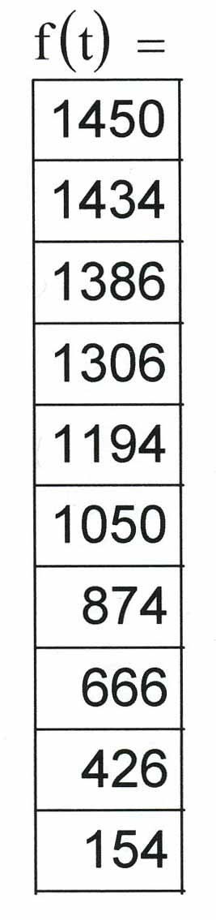
Example

Slide 5
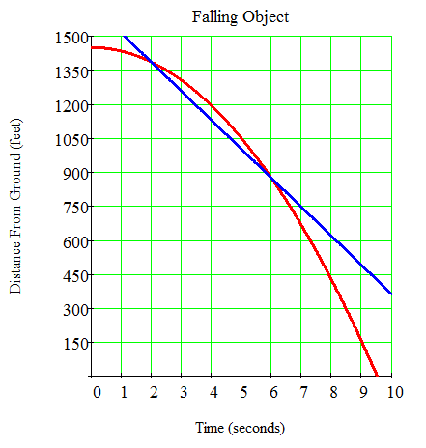
(a) Find the average velocity over the interval [2, 6] seconds.
Solution
Secant Line
Its slope represents the average velocity we get
So, the average velocity the object is falling over the time interval [2, 6] seconds is −128 ft/sec.
The negative sign indicates that the object is falling.

Slide 6
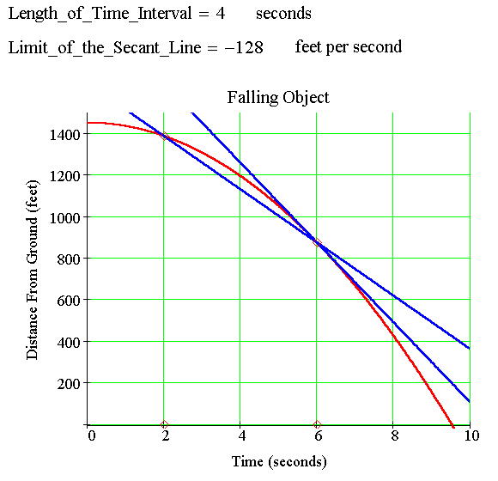
(b) Find the velocity at time 6 seconds.

Slide 7
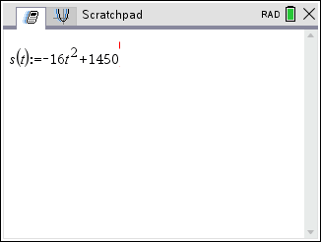
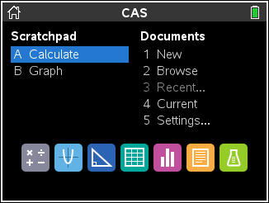
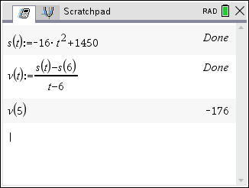
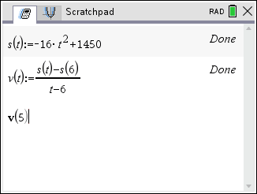

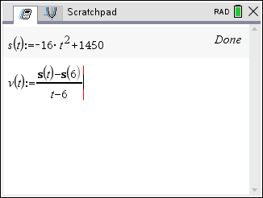
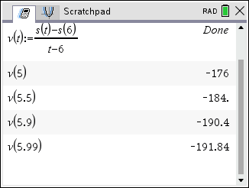
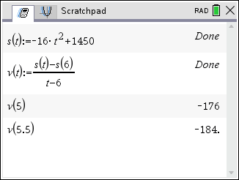
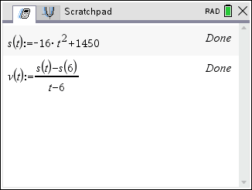
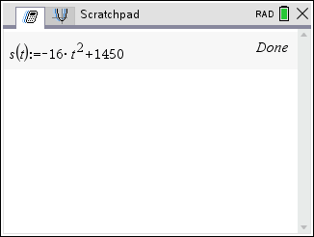
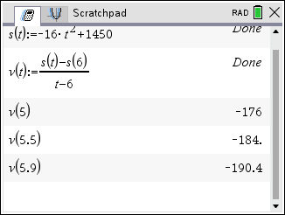
Tangent Line
(b) Find the velocity at time 6 seconds.
The slope of the tangent line represents the exact velocity of the object at time 6 seconds.
What is the slope?
So it appear the velocity at 6 seconds is close to −192 ft/s.

Slide 8
(b) Find the velocity at time 6 seconds.
The slope of the tangent line represents the exact velocity of the object at time 6 seconds.
What is the exact slope?
As t approaches 6, the limit of the secant line is the tangent line. We calculate the Instantaneous Velocity with the following limit

Slide 9
(b) Find the velocity at time 6 seconds.
Using limits we get
We say that the Instantaneous Velocity at t = 6 seconds is −192 ft/sec.

Slide 10
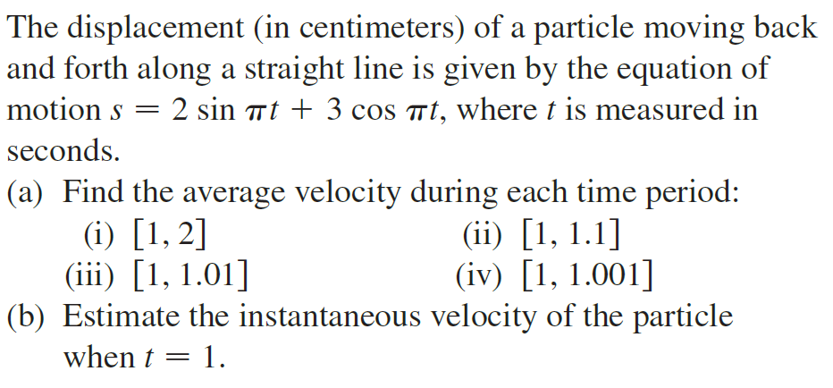



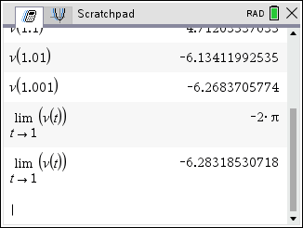
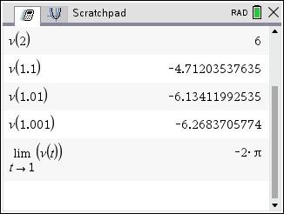
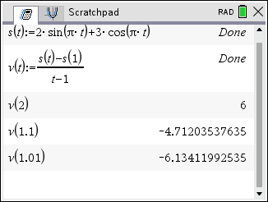
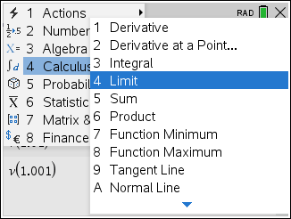
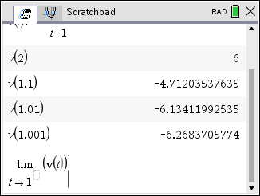
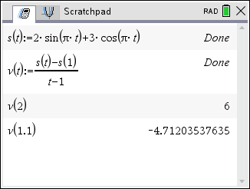
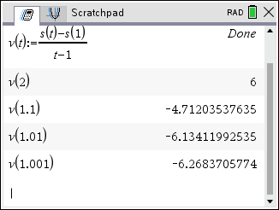
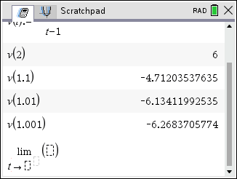
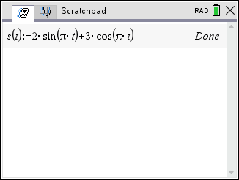
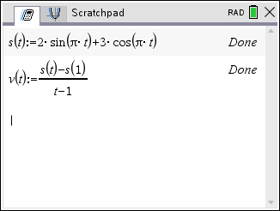
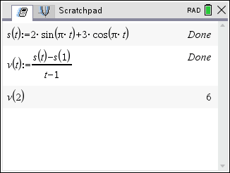
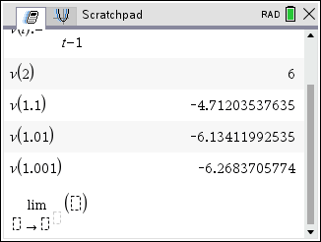
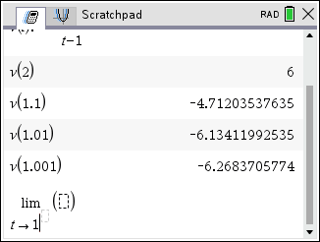
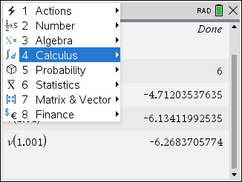






Example
Solution

